Slide 1







Welcomes
12 programmes accredited
Ranked 801-1000 in Rankings 2024
Ranked 801-850 in
World Rankings 2025
Ranked 46th in
Rankings 2024*
A Grade
* University Category

Slide 2
Assignment 2 = 40 marks
Test 2= 40 marks
Attendance = 10 marks
Discipline= 10 marks

Slide 3

NATURAL RESOURCES & BIODIVERSITY CONSERVATION

Slide 4
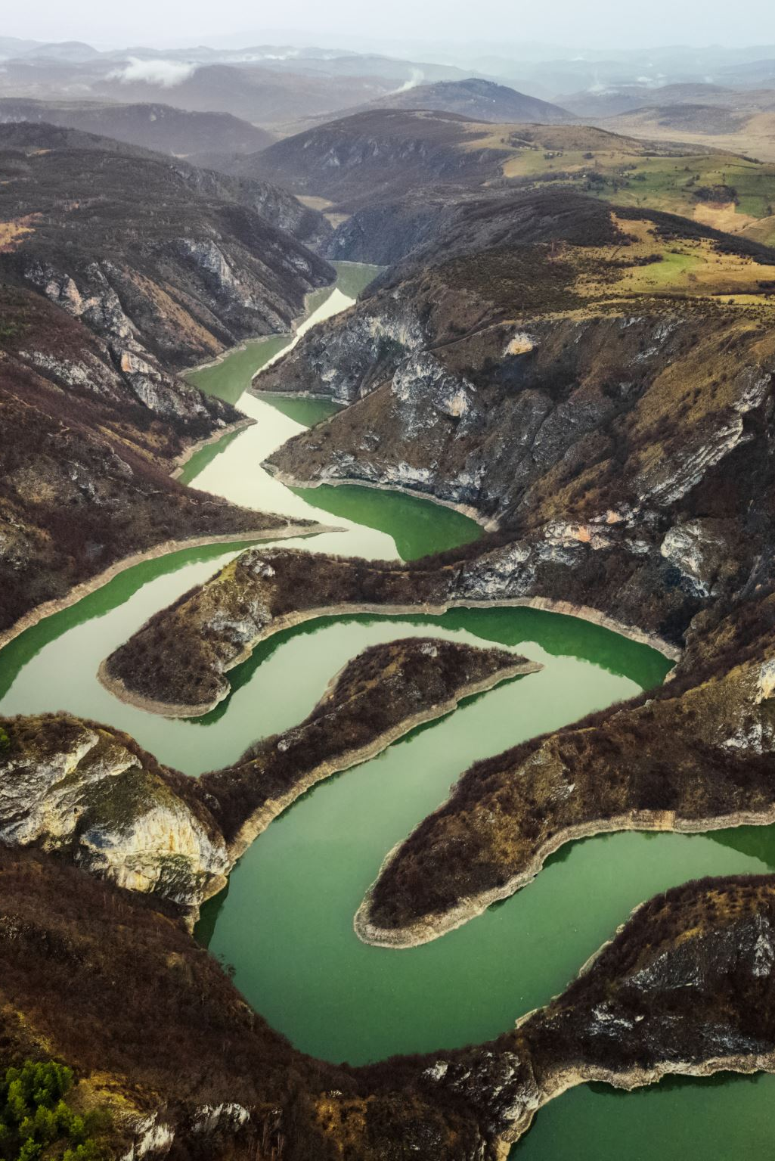
NATURAL RESOURCES
Any stock or reserves that can be drawn from nature is a natural resources.
Air
Water
Forest
Coal
Minerals
Soil

Slide 5
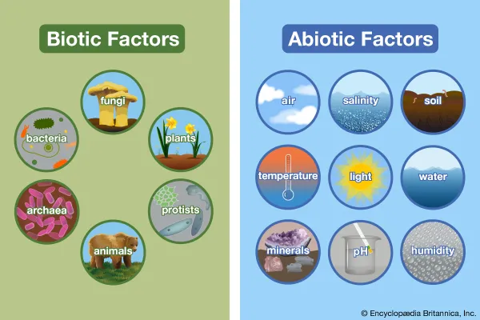
Based on their origin, Natural Resources are classified as biotic and abiotic resources.
Biotic: obtained from any component of biodiversity include forest and forest products, crops, birds, animals, fish and other marine life forms.
Coal, petroleum and mineral oils are also included in this category because they are originated from organic matter.
Abiotic: include air, water, land and minerals.

Slide 6
Renewable resources-Although exhaustible, these can be regenerated simultaneously along with their exploitation , and hence always available for use for longer periods . They can be maintained themselves by natural recycling and reproduction or can be replenished if managed wisely. They include forest, wildlife, wind energy, biomass energy ,tidal energy, hydro energy
Non-renewable resources– cannot be replenished or regenerated and hence , they get exhausted due to unlimited continuous use.
Example- coal ,Petroleum, minerals.

Slide 7
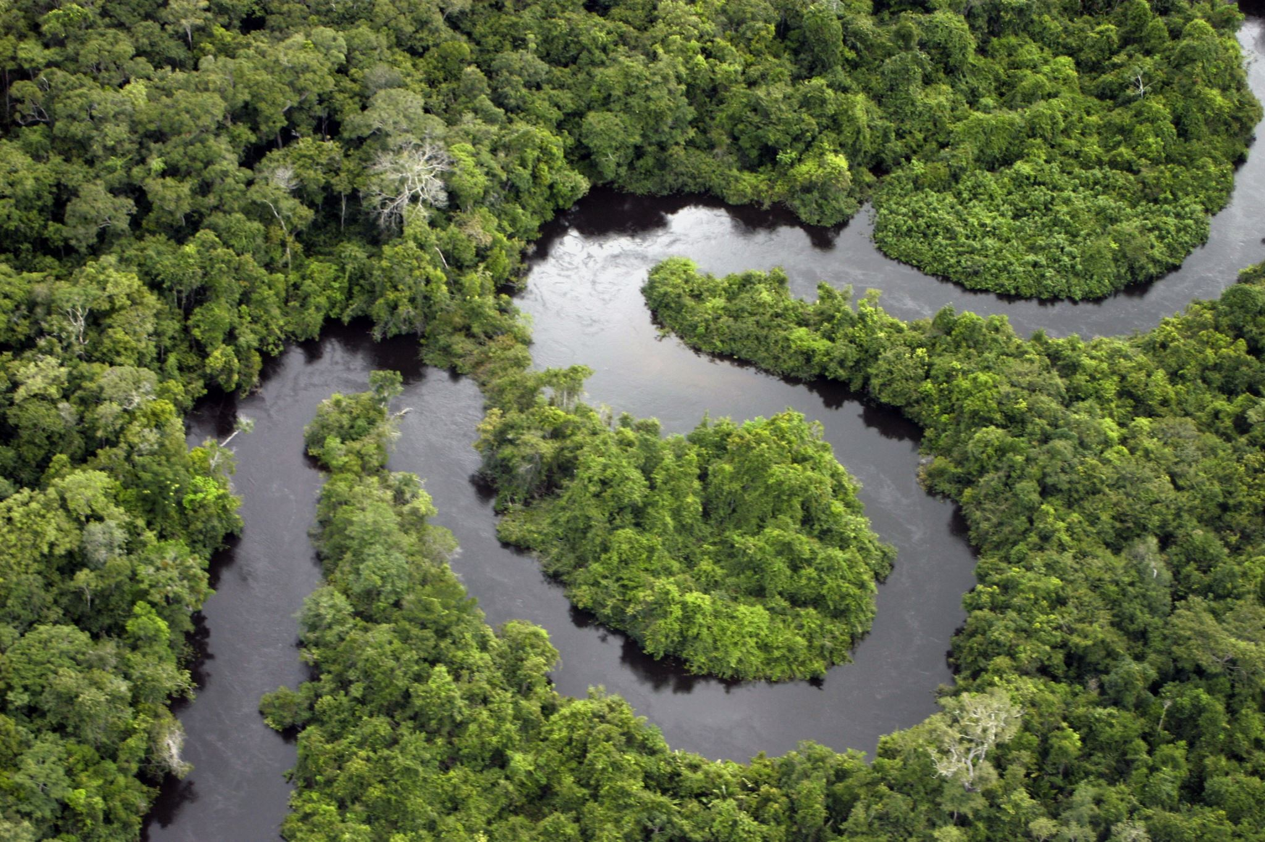
Natural Resources
Forest resources
Water resources
Mineral resources
Energy resources
Land resources
Biodiversity
Wild life

Slide 8
Forest resources
Natural resources
Covering earth like green blanket
Forest ecosystem is dominated by trees , their species-content varying in different parts of the world.
Produces innumerable goods and also environmental services
Forest contribute substantially to the economic development of our country by providing goods and services to the people and industry.

Slide 9
Uses of forest
Commercial use
Ecological use

Slide 10
Commercial use
Timber
Pulpwood
Fruits
Spices, beverages
Fodder
Rubber, Gum
Fibres
Drugs &medicines
Minerals
bamboo Cane

Slide 11
Ecological uses of Forest Resource
Production of oxygen
Reducing global warming
Wildlife habitat
Regulation of hydrological cycle
Soil conservation
Pollution moderator
Aesthetic and touristic value and serve as gene reserve of important species

Slide 12
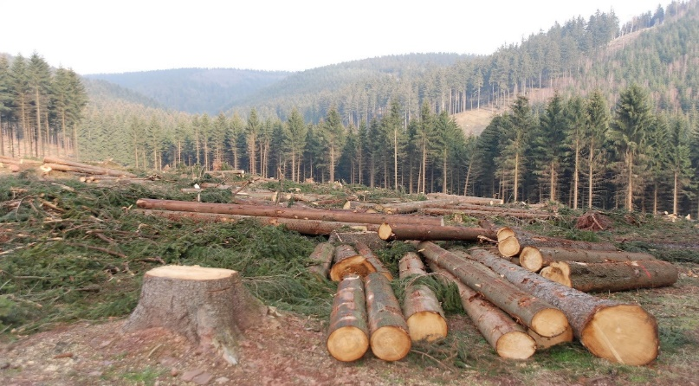
Deforestation
Cutting down of the forest at large scale
Total forest of the world in
1900 ------7,000 million hectare.
1975------ 2890 million hectare.
2000-------2,300 million hectare.
https://www.google.com/search?q=deforestation&sxsrf=APq-WBtlccCSSkFutXIX1maM-bq6YXWV4w:1644847621919&source=lnms&tbm=isch&sa=X&ved=2ahUKEwi04Nrxrv_1AhVz7HMBHQMNCOEQ_AUoAXoECAkQAw&biw=1242&bih=597&dpr=1.1#imgrc=lUhNXftWfrJc8M

Slide 13
Reasons for Deforestation
Shifting cultivation
Fuel requirements
Raw materials for industrial use
Development projects
Growing food needs
Overgrazing
Forest fires

Slide 14
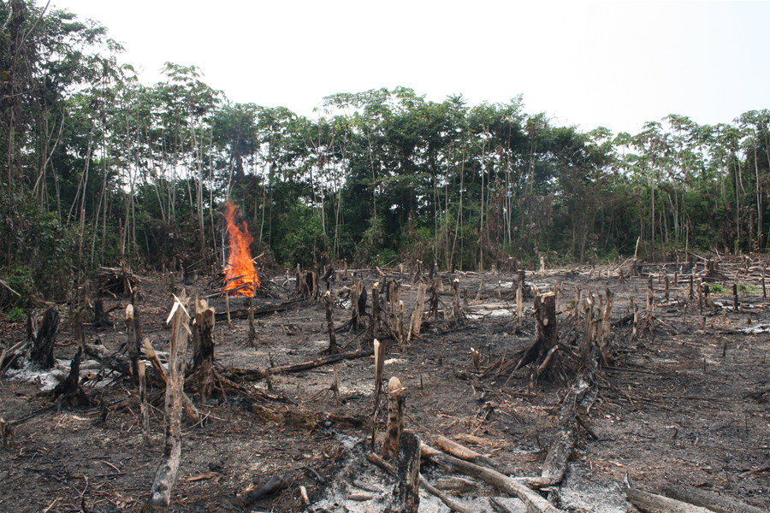
Shifting Cultivation: There are an estimated 300 million people living as shifting cultivators who practice slash and burn agriculture and are supposed to clear more than 5 lakh ha of forests for shifting cultivation annually. In India, we have this practice in North East and to some extent in Andhra Pradesh, Bihar and M.P which contribute to nearly half of the forest clearing annually.
https://www.bibalex.org/SCIplanet/en/Article/Details.aspx?id=5180
Fuel requirements: Increasing demands for fuel wood by the growing population in India alone has shoot up to 300-500 million tons in 2001 as compared to just 65 million tons during independence, thereby increasing the pressure on forests

Slide 15
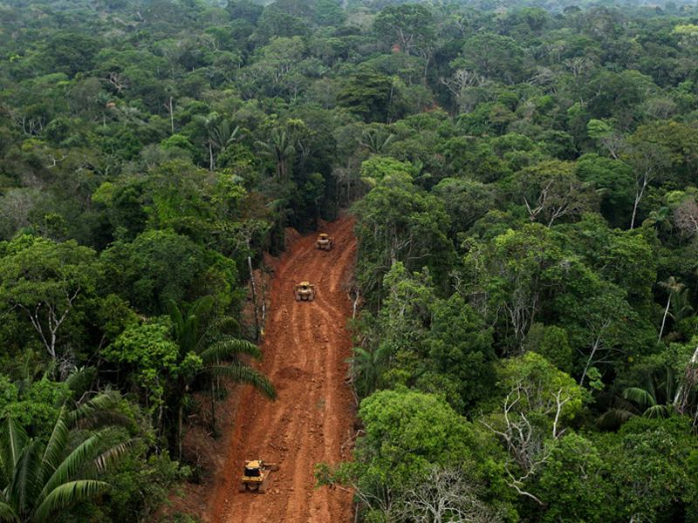
Raw materials for industrial use: Wood for making boxes, furniture, railway-sleepers, plywood, match-boxes, pulp for paper industry etc. have exerted tremendous pressure on forests. Plywood is in great demand for packing tea for Tea industry of Assam while fir tree wood is exploited greatly for packing apples in J&K.
Development projects: Massive destruction of forests occur for various development projects like hydroelectric projects, big dams, road construction, mining etc.
https://wrm.org.uy/articles-from-the-wrm-bulletin/viewpoint/infrastructure-and-extraction-a-host-of-deforestation/

Slide 16
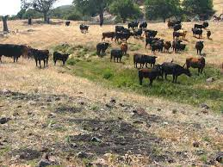
Growing food needs: In developing countries this is the main reason for deforestation. To meet the demands of rapidly growing population, agricultural lands and settlements are created permanently by clearing forests
Overgrazing: The poor in the tropics mainly rely on wood as a source of fuel leading to loss of tree cover and the cleared lands are turned into the grazing lands. Overgrazing by the cattle leads to further degradation of these lands
https://lpfw.org/our-work/ending-resource-abuse/overgrazing/

Slide 17
Consequences of deforestation
It threatens the existence of many wildlife species due to destruction of their natural habitat.
Biodiversity is lost and long with that genetic diversity is eroded.
Hydrological cycle gets affected, thereby influencing rainfall.
Problems of soil erosion and loss of soil fertility increase. In hilly areas it often leads to landslides
More carbon is added to the atmosphere and global warming is enhanced.

Slide 18
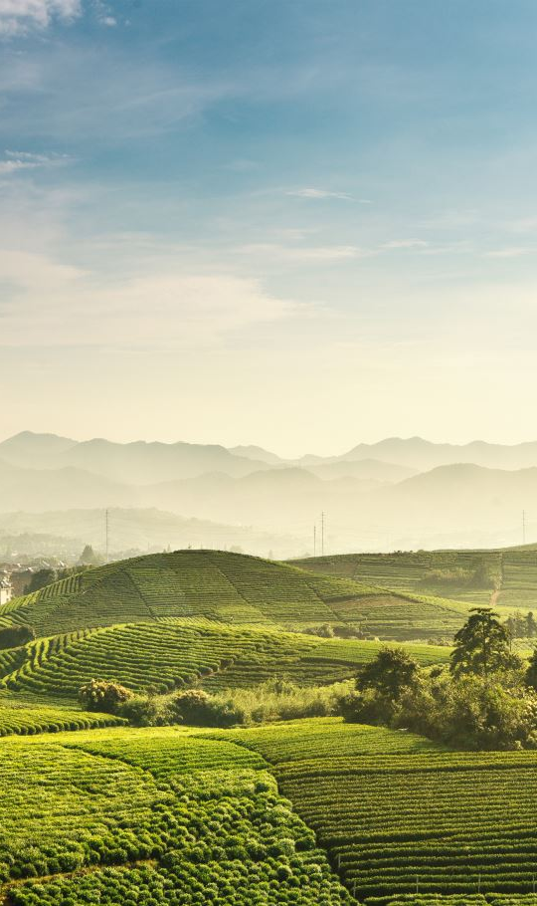
Case study
Disappearing of tea gardens in Chhota Nagpur
Hilly area
Receive afternoon showers fairly frequent on afternoon favoring tea plantation.
Destruction of forest, rainfall declined .
Tea gardens disappeared.

Slide 19
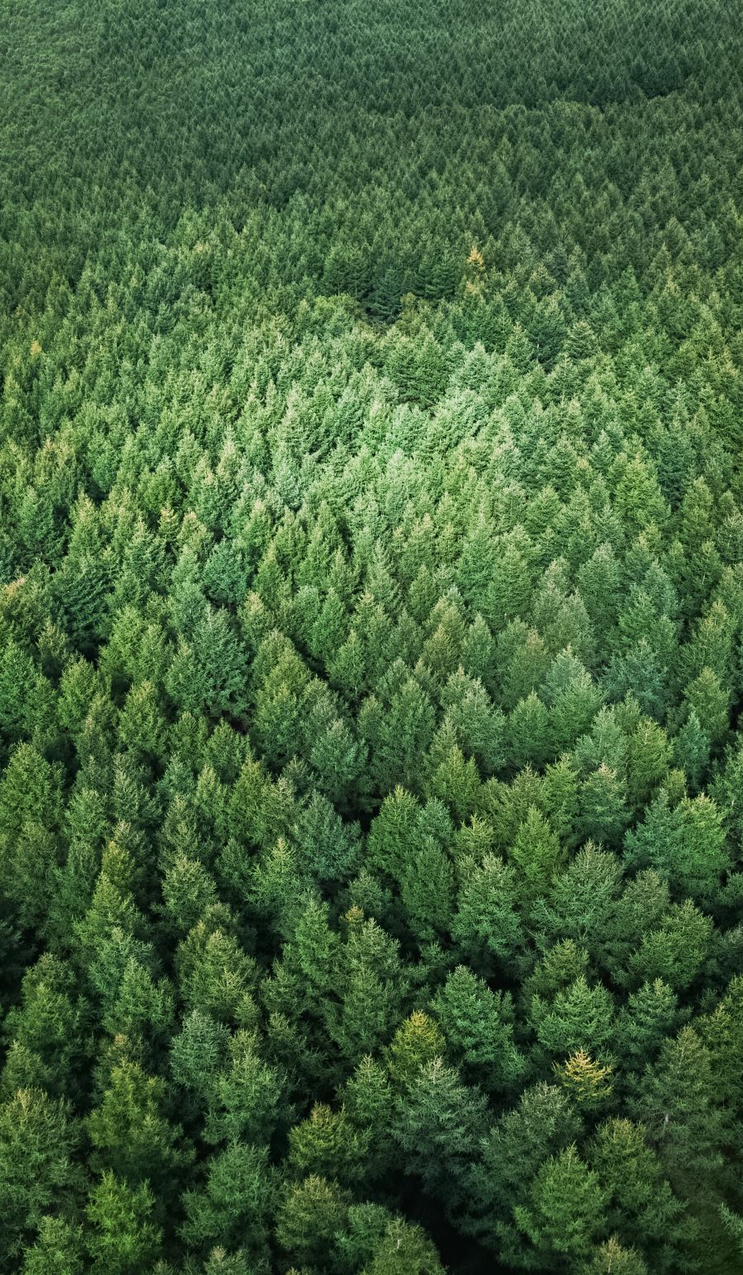
Declining of rainfall in Ooty
Nilgri hills
Annual rainfall is very high
1965-84 subnormal rainfall in the wooded area
Reason
Declining of forest in past 20 years

Slide 20
Desertification in hilly regions of Himalayas
Monoculture (Pinus roxburghii, Eucalyptus camaldulensis).
Effects
Upset ecosystem by changing edaphic and biological properties
Nutrient cycling has become poor ,original rich germplasm is lost.
Area is invaded by exotic weed.
These areas are not able to recover and are losing their fertility.
Areas: Entire Khasi hill district of Meghalaya in North East Himalayas, Ladakh and parts of Kumaon and Garhwal

Slide 21

Forest management
Afforestation: planting trees on barren land.
For one tree cut 10 tress should be planted.
Afforestation done by following ways :
Commerical forestry
Social forestry
Agroforestry

Slide 22
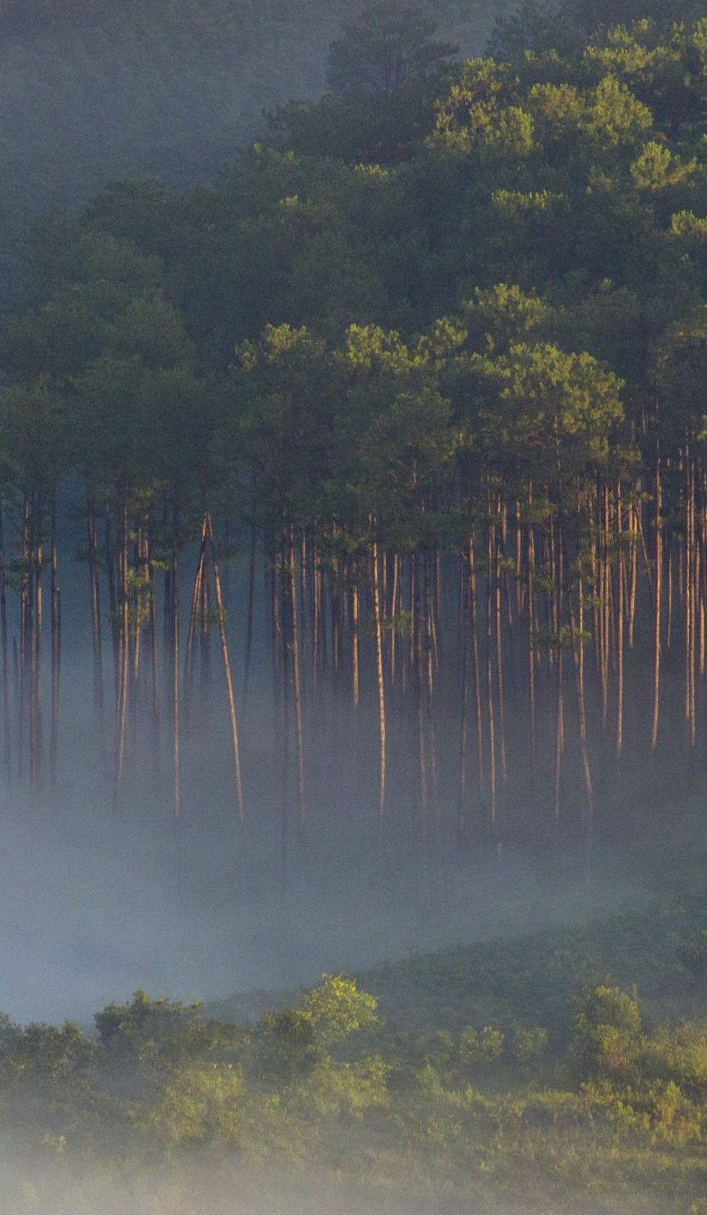
COMMERICAL FORESTRY
Involves intensive plantation of trees on available land or on land not under agriculture with the aim of fulfilling the commercial demand ,without causing denudation of natural forests.
Generally fast growing trees (Eucalyptus, Acacia) are raised under modern techniques. The production forestry programmes include social forestry, agro forestry and urban forestry programme.

Slide 23
Social forestry
Involves raising of trees for firewood, fodder, agricultural implements and fruits on public, roads, rails and common land for the benefits of rural community. It reduces pressure on the existing forests.
A number of indigenous and /or exotic species which can meet the requirement of rural community are used for plantation in social forestry.

Slide 24
Agro forestry
This programme aims at surviving an ancient practice of using the same land for farming and forestry. Under this programme woody species are grown in combination with herbaceous crops ,either at the same time or in time sequence .

Slide 25

Minerals
Are naturally occurring, inorganic, crystalline solids having a definite chemical composition and characteristics physical and chemical properties.

Slide 26
Uses of minerals
Generation of power eg coal, lignite
Development of industrial plant and machinery
Construction ,housing and settlement
Defence equipments ---weapons
Transportation means
Communication -----telephone wires and cables
Medicinal systems
Formation of alloys for various purposes
Jewellery eg ---------gold

Slide 27
Types of minerals
Critical minerals are essential for the economy of a nation like aluminium, copper, gold
Strategic minerals are those required for the defence of a country eg Manganese ,cobalt, platinum, chromium.

Slide 28
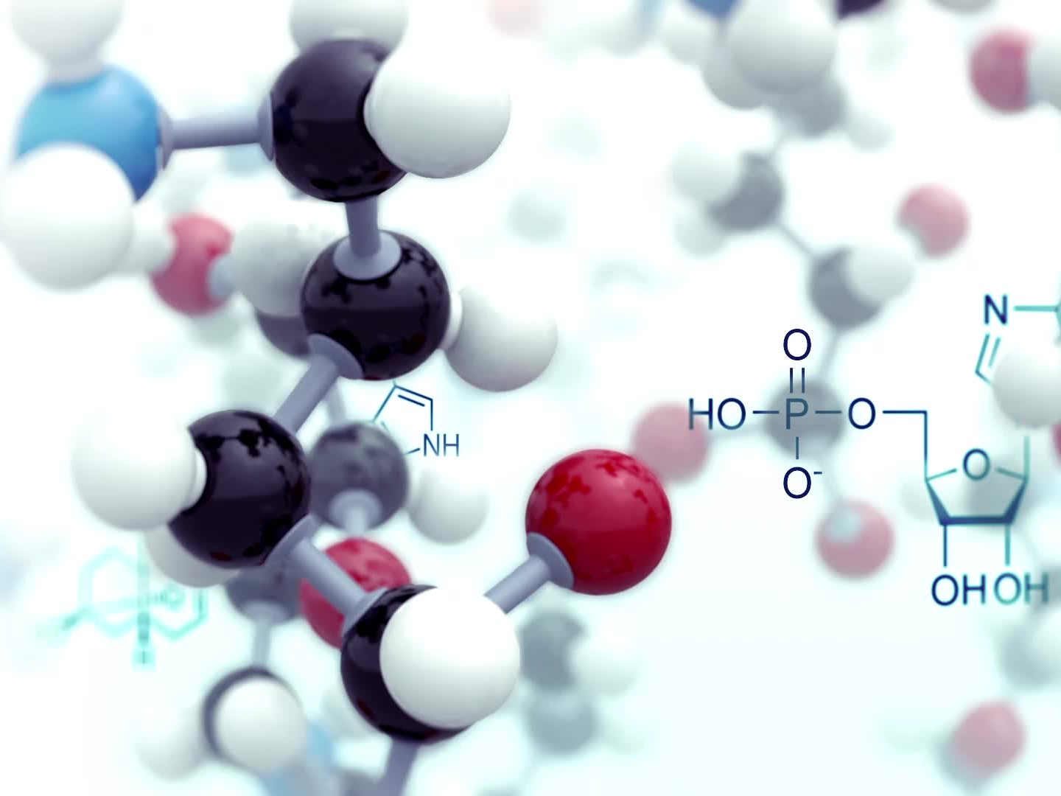
Based on properties Minerals are 2 types

Slide 29
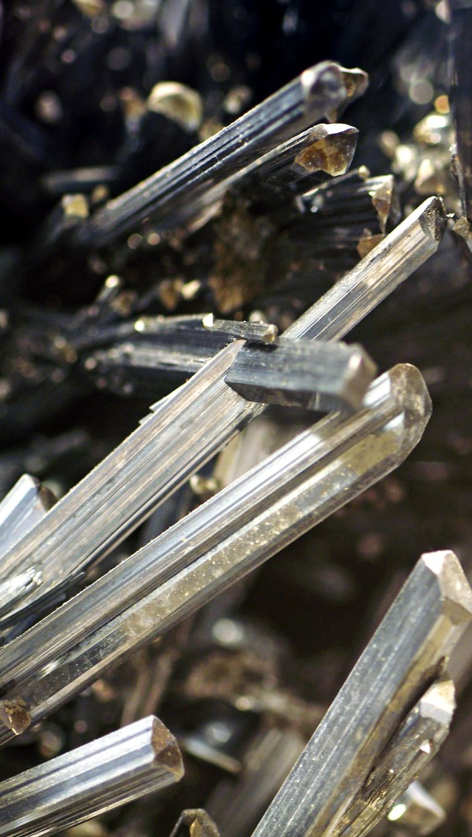
Metallic minerals
Under this category are mainly iron, non-ferrous metals, silver and gold are important.

Slide 30

Non Metallic minerals
Eg graphite, diamond, silver &platinum.

Slide 31
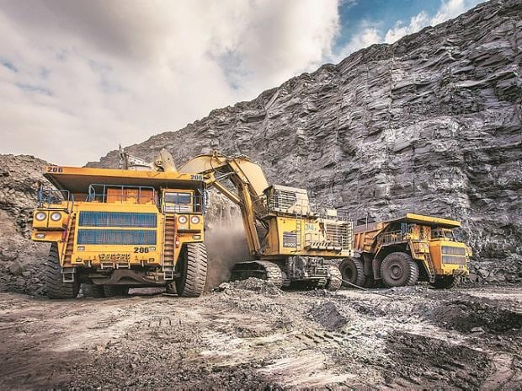
Mining
Is the extraction of minerals and coal from earth surface
Mining are of 2 types
Surface mining
Sub surface mining
https://www.business-standard.com/article/economy-policy/govt-ends-monopoly-over-coal-opens-mining-sector-to-private-players-120051700021_1.html

Slide 32
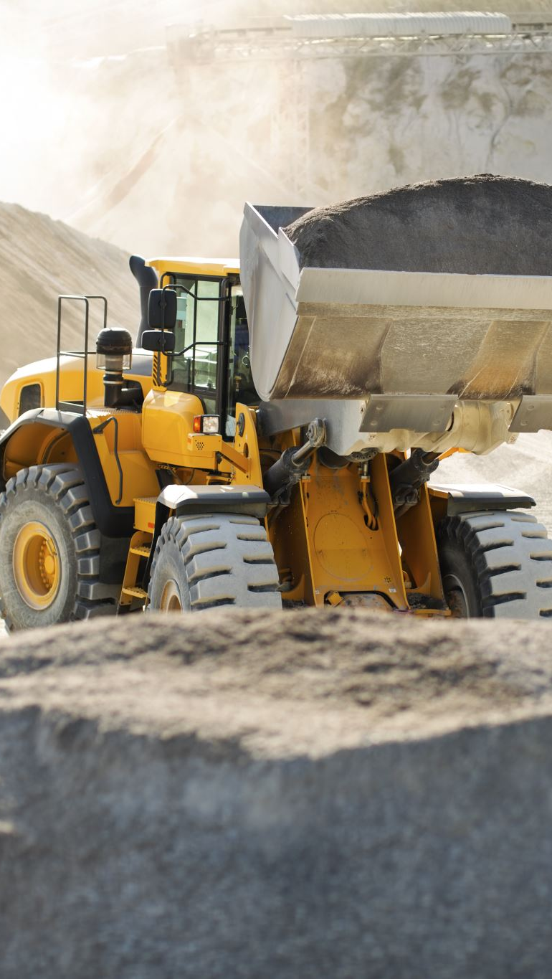
Sub Surface mining
is done to extract minerals ( or fossil fuels ) from deep deposit in soil by using sub surface mining .

Slide 33
Surface mining
Extraction of minerals from shallow deposit is known as surface mining .
Surface mining can make use of any of three types
Open pit mining
Dredging
Strip mining

Slide 34
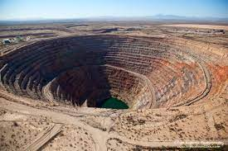
Open pit mining
In which machines dig holes and removes the ores ( example copper, iron, gravel, marble)
https://www.911metallurgist.com/blog/open-pit-mining-safety

Slide 35
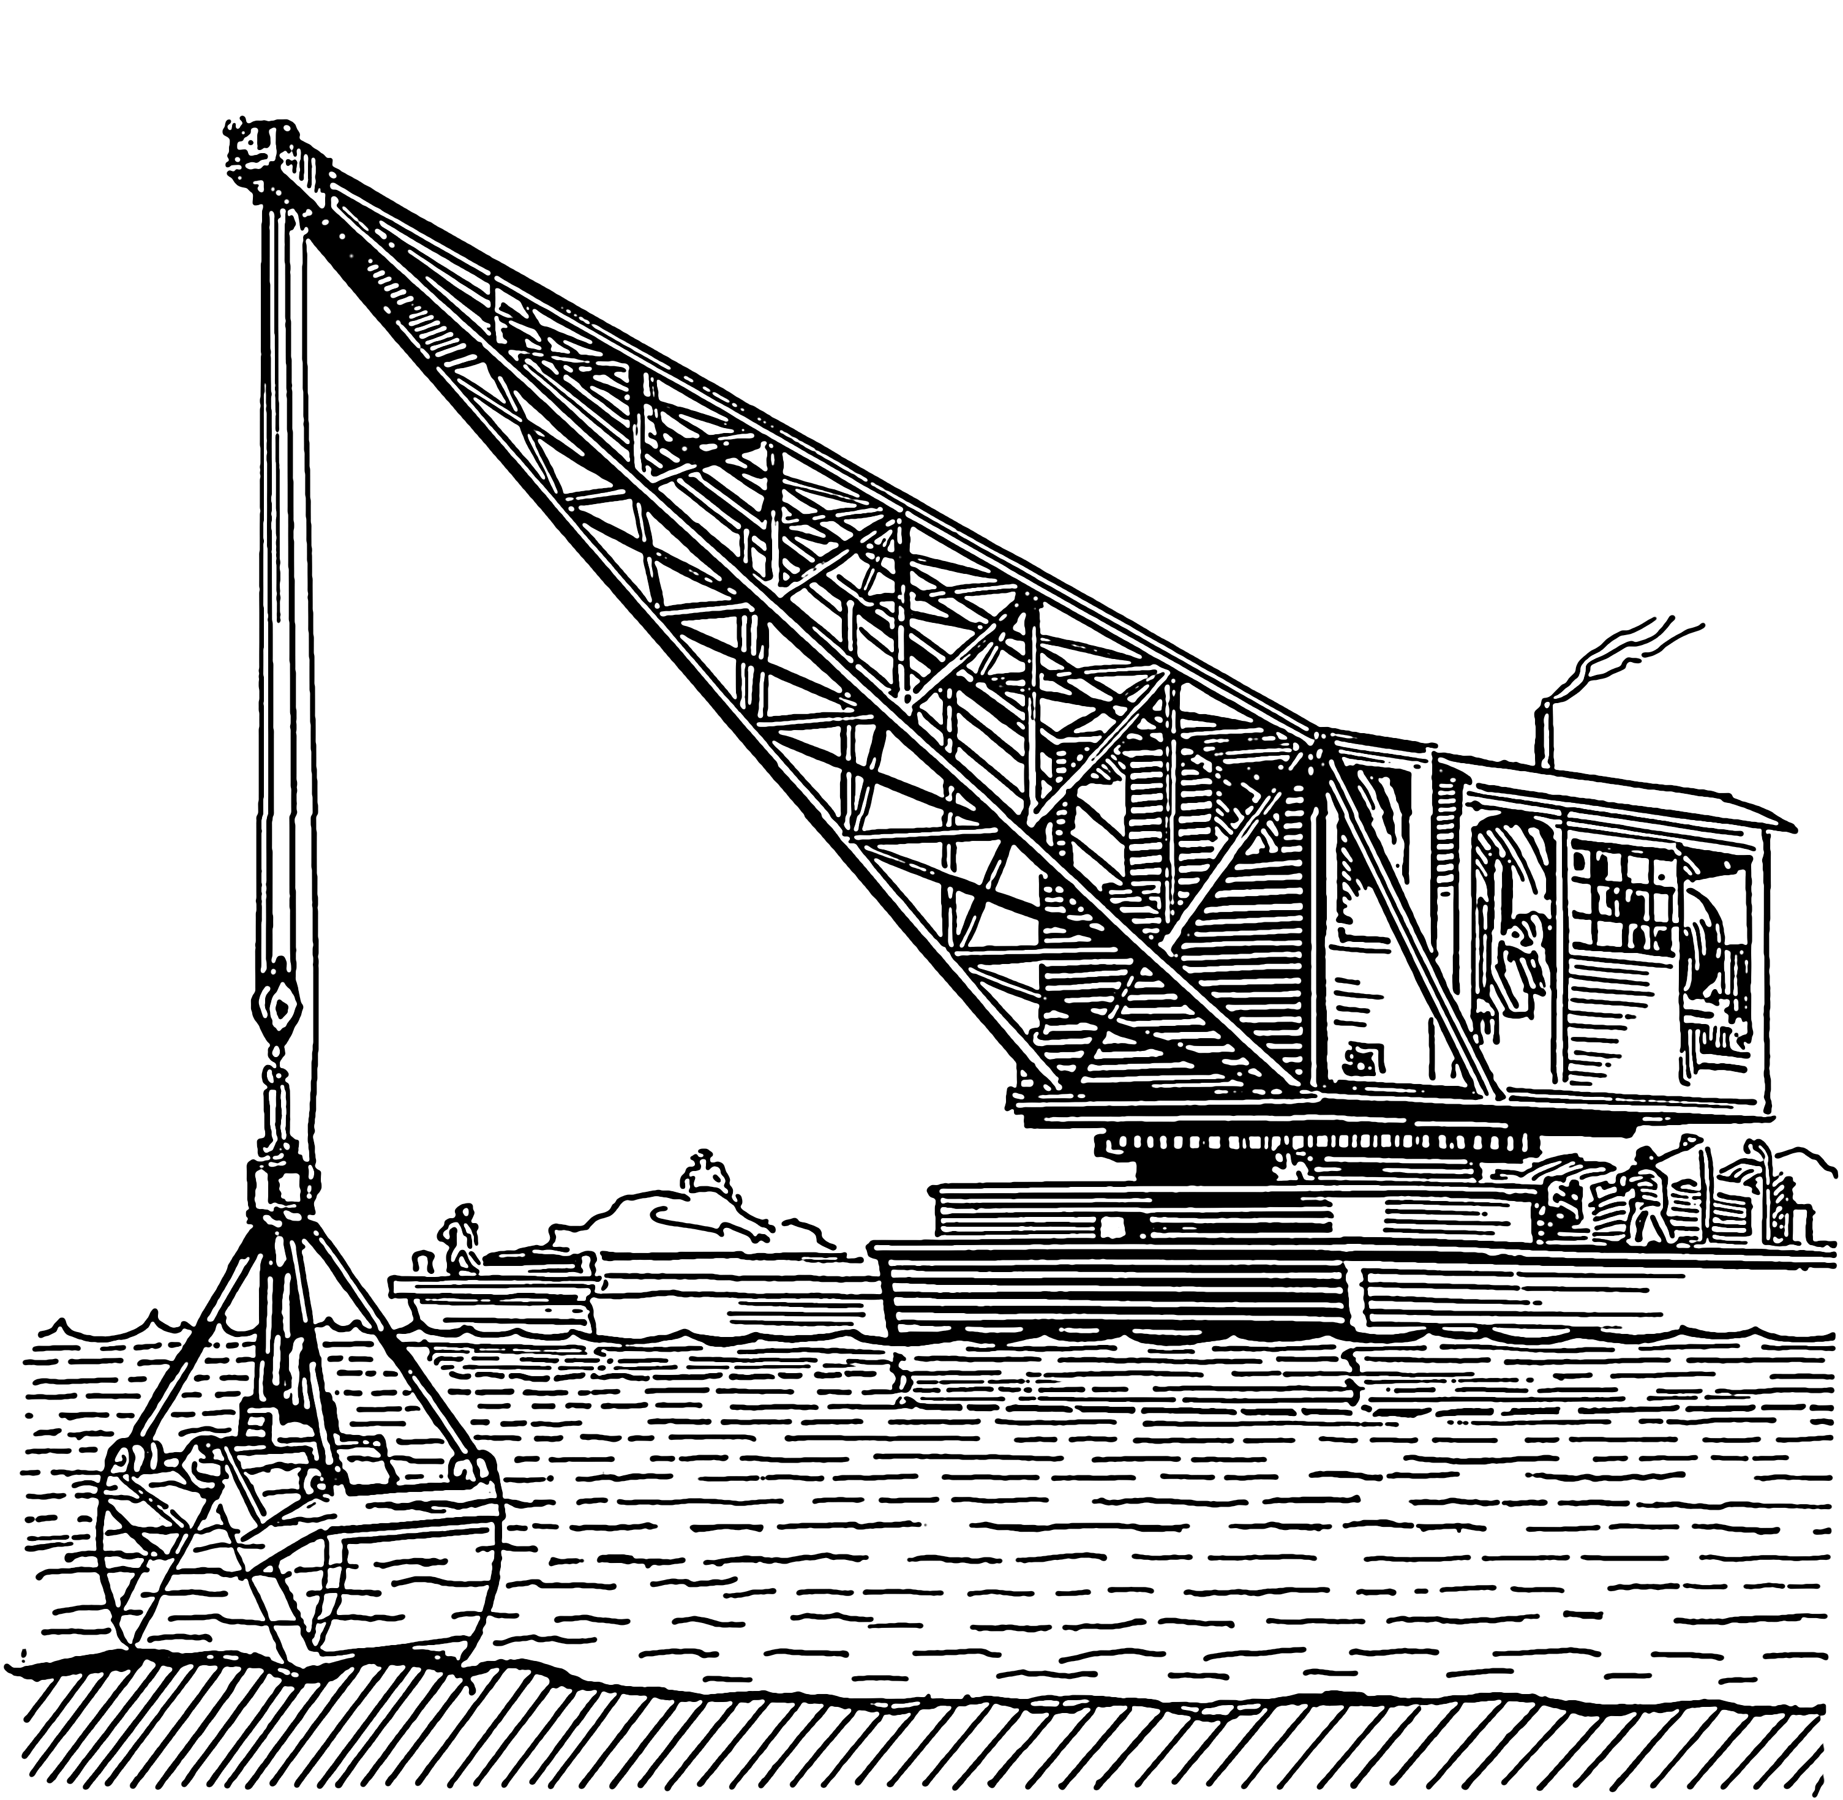
Dredging
In which chain buckets and draglines are used which scrap up minerals from underground water minerals deposits
https://en.wikipedia.org/wiki/Dredging

Slide 36
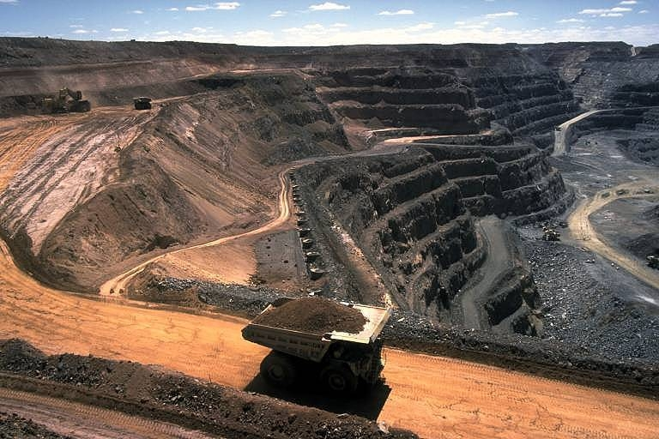
Strip mining
In which ores is stripped off by using bulldozers, power shovels and stripping wheels( eg phosphate rocks)
https://scied.ucar.edu/image/coal-strip-mine

Slide 37
Impacts of mining
De-vegetation and defacing of landscape
Subsidence of land
Groundwater contamination
Surface water contamination
Air pollution
Occupational health hazards

Slide 38
Devegetation and defacing of landscape
Topsoil and vegetation is removed from mining area to get assess of minerals
Large scale deforestation or devegetation leads to ecological loss
Landscape get badly affected
Huge quantities of debris and alongwith big scar and disruption of spoil aesthetic value
Make more prone to soil erosion.

Slide 39
Subsidence of land
Associated with underground mining
It results in –
Tilting of buildings
Cracks in houses
Buckling of roads
Bending of rail tracks
Leaking of gas from cracked gas pipelines

Slide 40
Groundwater contamination
Mining Pollutes Groundwater
Affects Hydrological Cycle
Sulphur Normally Present As Impurity In Ore Get Converted Into Sulphuric Acid Through Microbial Action
Some Heavy Metals Leached Into Groundwater Contaminated It
Posing Health Hazards

Slide 41
Surface water pollution
Acid Mine Drainage Often Contaminates The Nearby Streams And Lakes.
The Acidic Water Detrimental To Aquatic Life
Radioactive Material Affects The Aquatic Life
Heavy Metals Contaminates The Water Body And Affects The Aquatic Life

Slide 42
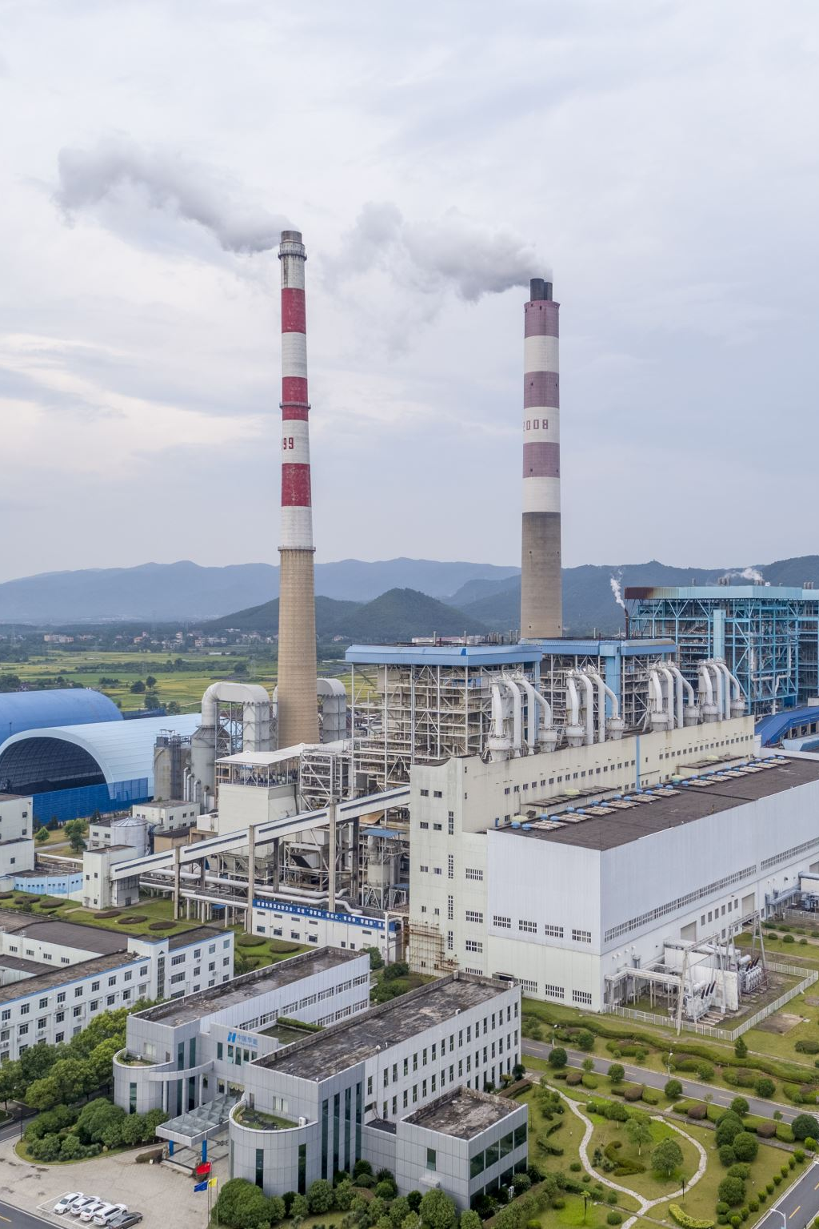
Air pollution
Smelting is done to purify the metals from other impurities
During smelting enormous quantities of air pollutant released affects vegetation and causes serious environmental impacts.
Example SPM, soot, lead, cadmium shoot up in smelter atmosphere causes health problems

Slide 43
Occupational health hazards
Miners suffers from respiratory and skin problems due to constant exposure to SPM and other toxic

Slide 44
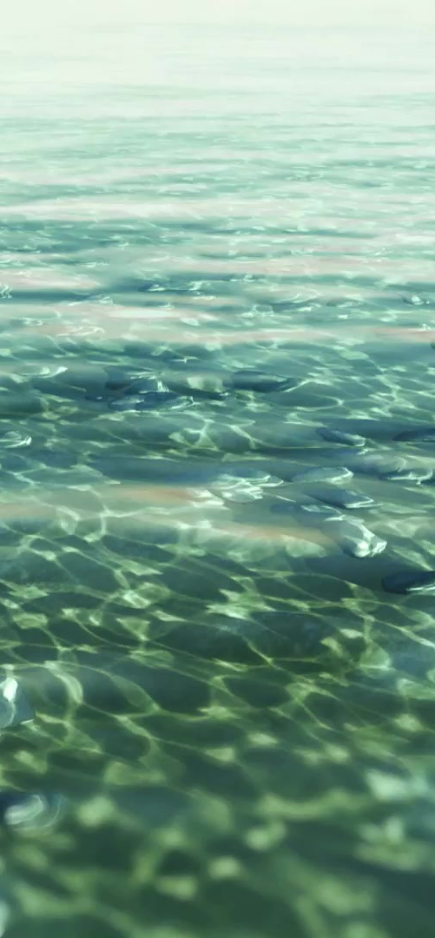
Water resources
Indispensable resource
60-65% of animal and plant is made up of water
97% is salty water and only 3% is fresh water available .
Rest of the fresh water is capture in polar cap.
o.003% is available as fresh water
Groundwater
Surface water

Slide 45
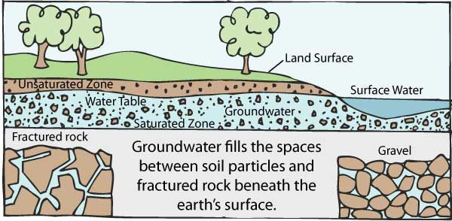
Groundwater
9.86% of the total freshwater is in the form of groundwater.
35-50 times of that of surface water supplies
https://www.groundwater.org/get-informed/basics/groundwater.html

Slide 46
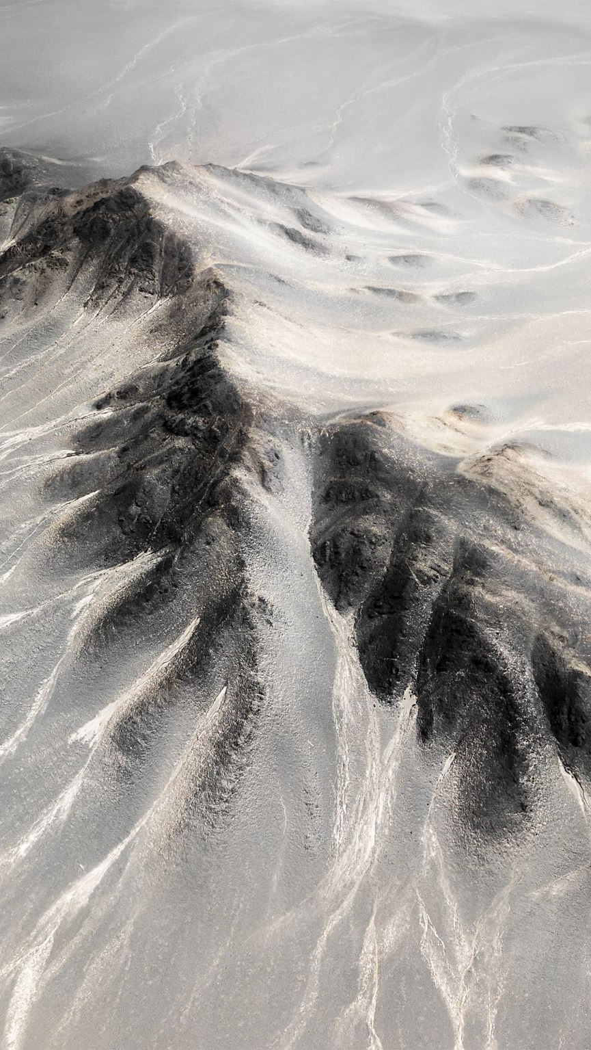
Aquifers
Water which percolates down the soil and is not picked by the roots ,moves downward slowly until it reaches an impervious layer of rocks
When the water get accumulated/trapped in the porous strata of rocks it forms aquifers

Slide 47
Types of aquifers
Confined aquifers
Unconfined aquifers

Slide 48
Confined aquifers
When water gets accumulated between two layers of rocks in both layers are impervious
Unconfined aquifers
When water gets accumulated between two layers of rocks in which lower layers is impervious and upper layer is pervious.

Slide 49
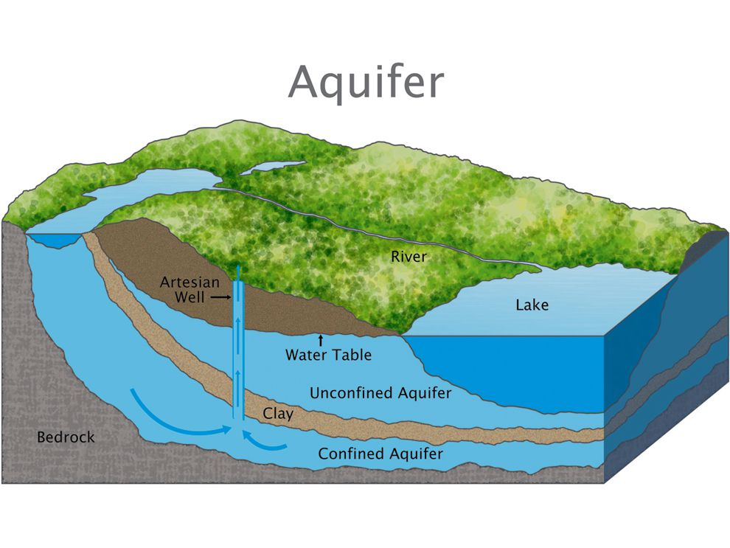
https://www.nationalgeographic.org/media/aquifer-illo/

Slide 50
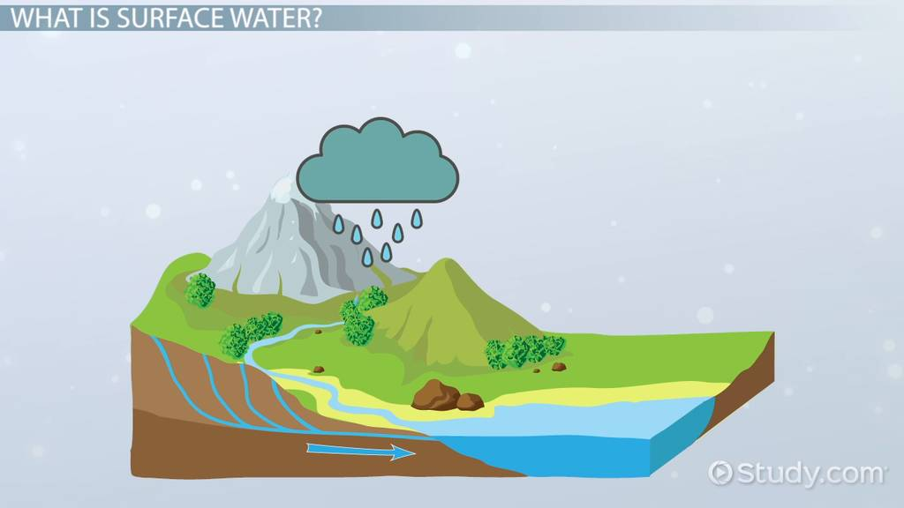
Surface water
Water coming through precipitation (rainfall, snowfall) when does not percolate down into the ground or does not return to the atmosphere as evaporation or transpiration loss ,assumes the form of streams, ponds, wetlands known as surface water
https://study.com/academy/lesson/surface-water-definition-properties.html

Slide 51
Floods
Countries like India and Bangladesh rainfall does not occur throughout the year.
Concentrated in June –September.
Heavy rainfall often causes floods in the low lying coastal areas.
Prolonged downpour causes the overflowing of the rivers and lakes resulting into floods.

Slide 52
Causes of floods
Deforestation
Overgrazing
Mining
Rapid industrialization
Global warming

Slide 53
Solution
Networking of rivers
Building of dams
Afforestation

Slide 54

Drought
When annual rainfall is below normal and less than evaporation ,drought condition are created .

Slide 55
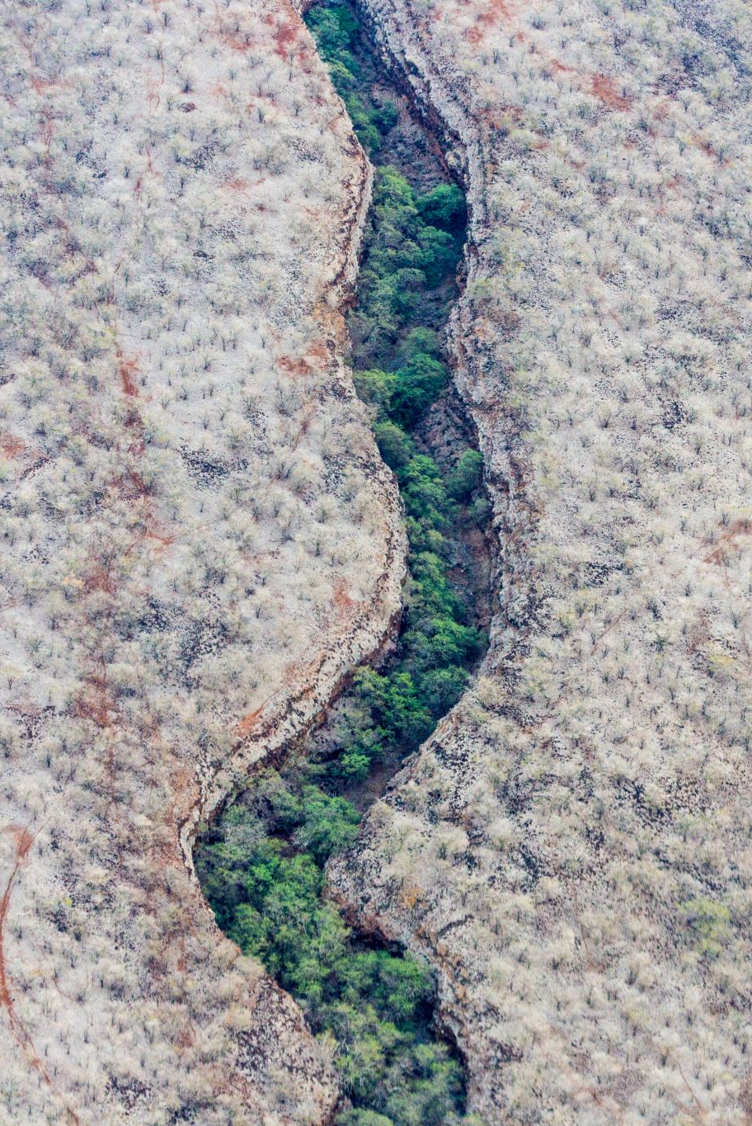
Causes
Overgrazing
Deforestation
Mining

Slide 56
Solution
Mixed cropping
Social forestry and waste land reclamation.

Slide 57
Cyclones
Recurring phenomena in the tropical coastal regions.
Tropical cyclones in warm ocean formed because of heat and moisture.
Requirement for tropical cyclones is that sea surface temperature should be above 26 degree Celsius.
It moves like spinning top at the speed of 10-20 km /hr.

Slide 58
They may last for a week or so and have a diameter varying between 100 to 1500 km.
Since in Western parts of the main ocean no cold current exist ,tropical cyclones originates here.
Tropical cyclones are called
Hurricanes in the Atlantic, Caribbean and north eastern pacific
Typhoons in western pacific
Cyclones in Indian Ocean
Willy willies in the sea around Australia

Slide 59
The devastation is more when storm surge and normal astronomical tide coincide.
Sea water with combines forces rushes inland and inundates the low lying areas.
Management
Planting more trees on the coastal belt
Construction of dams, dykes, embankments, storm shelter, wind breaks
Proper drainage
Wide roads for quick evacuation

Slide 60
Tsunamis
Japanese word
“Tsu” means harbor.
“Nami” stands for waves
Tsunamis are large waves generated when the sea floor is deformed by seismic activity ,vertically the overlying water in the ocean.

Slide 61
Tsunamis (Contd..)
It occur due to volcanic eruption and landslides in the ocean bed.
New phenomenon to Indonesia ,India, Srilanka ,Thailand
An eroded beach front is more prone to onslaught of tsunami waves.
Reduction in the thickness of the sand dunes
Also reduces the availability of good quality of groundwater.

Slide 62
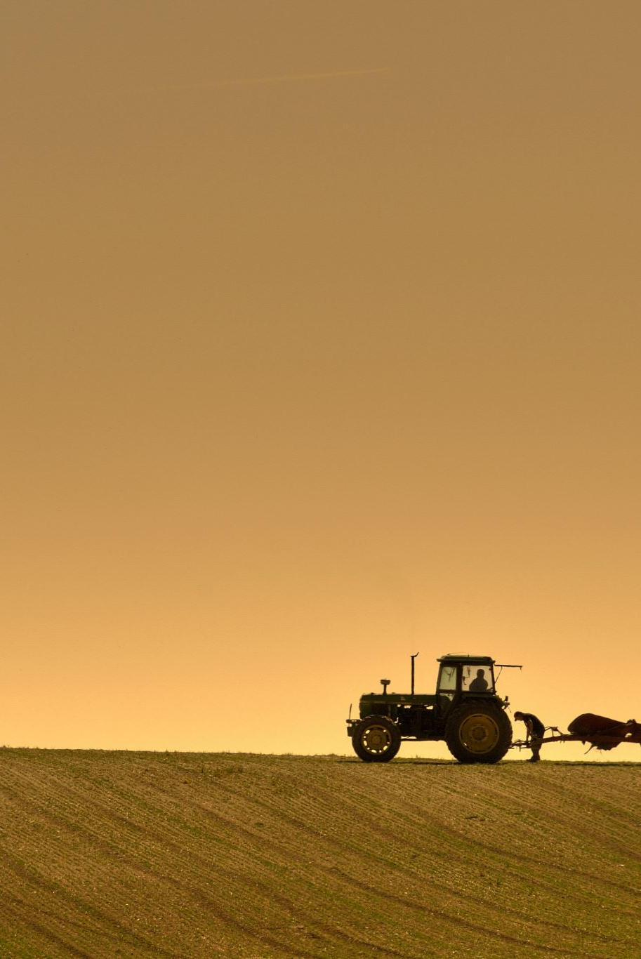
Agriculture
Man was a just hunter or gatherer quiet like a animal.
10,000-12,000 years back he took agriculture by cultivating plant of his own choice
he used slash and burn agriculture(Traditional Agriculture)

Slide 63
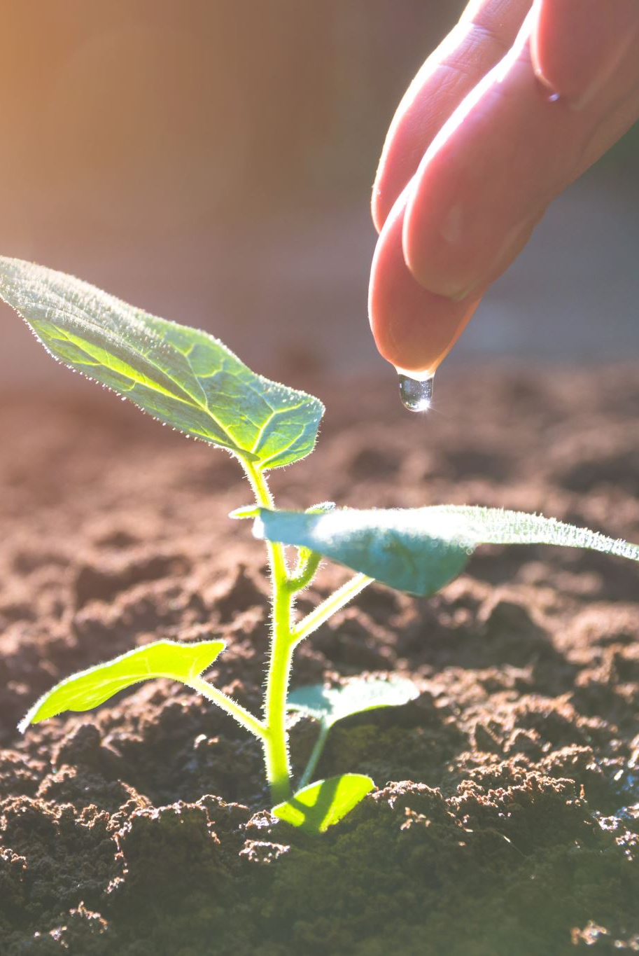
Traditional agriculture and its impacts
Used
Simple tools
Small plot
Naturally available water
Organic fertilizer
Mix crop

Slide 64
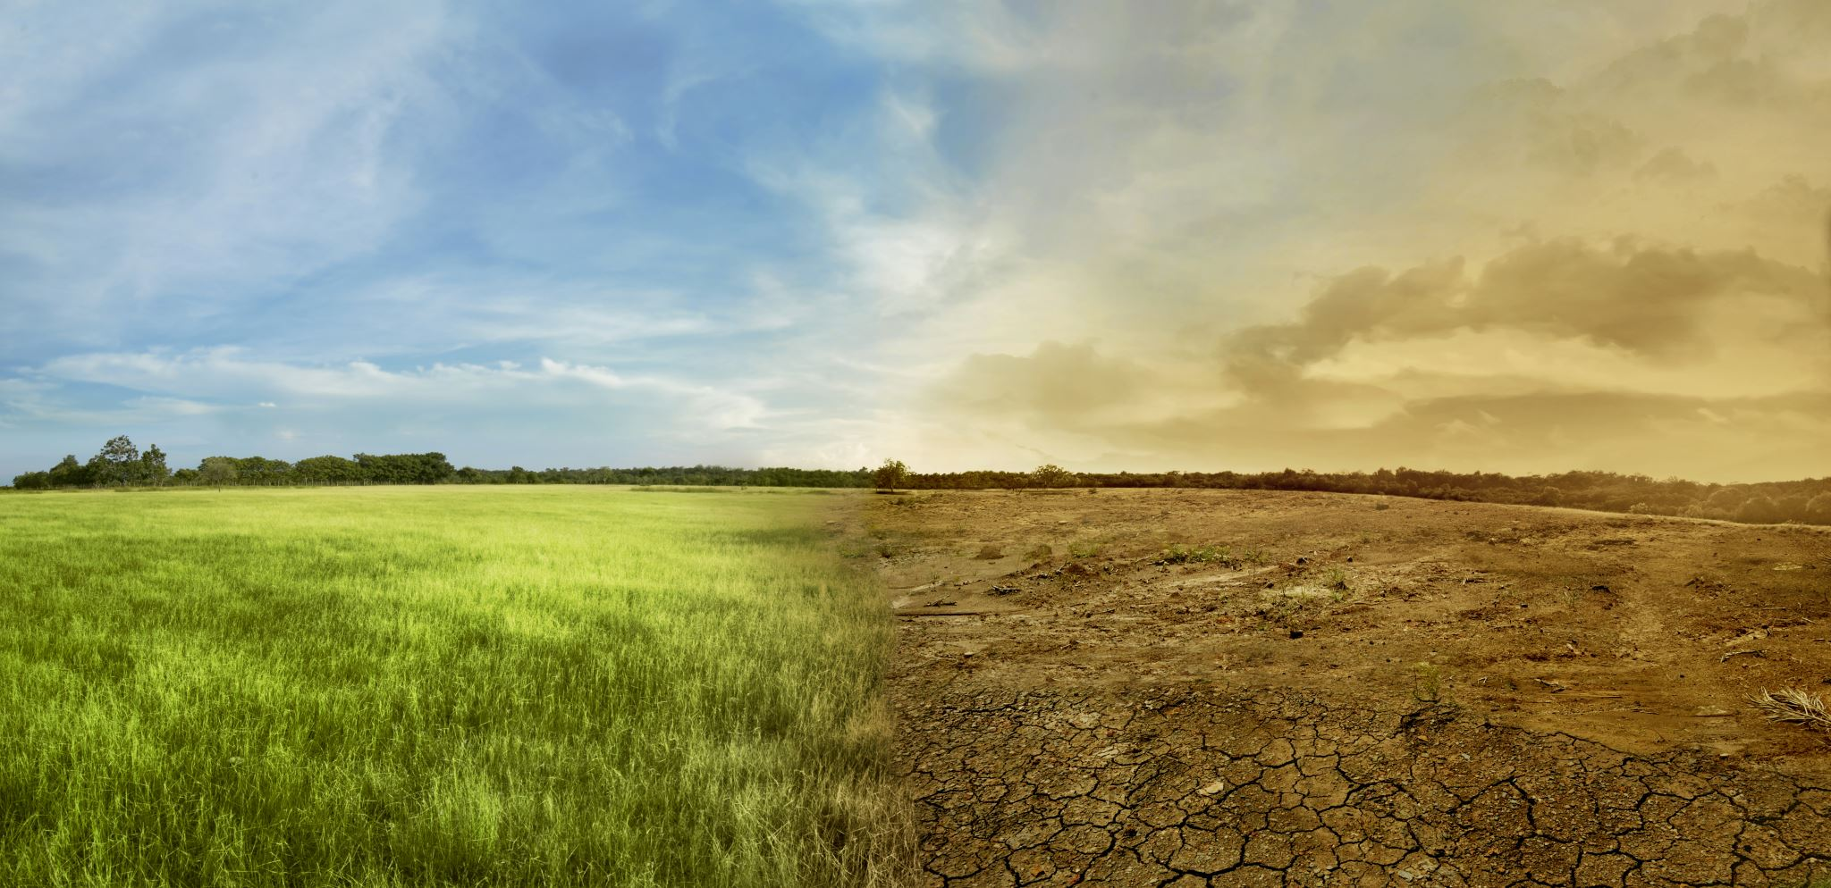
Impacts of Traditional Agriculture
Deforestation
Soil erosion
Depletion of nutrients

Slide 65
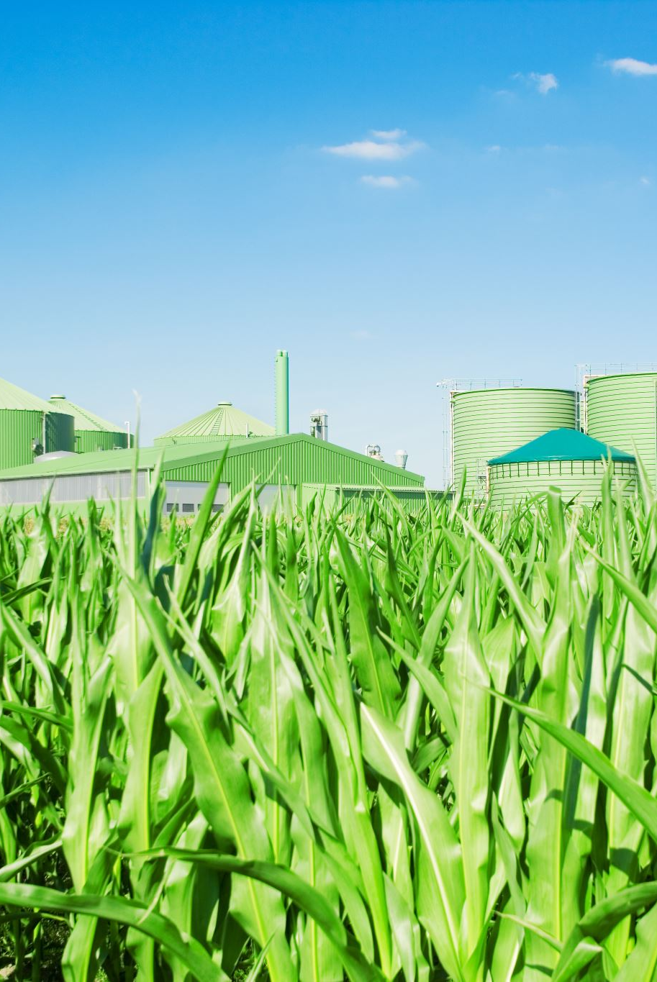
Modern agriculture
Use
Hybrid seeds of selected and single crop varieties.
High tech equipments
Lots of energy subsides in the form of fertilizers, pesticides ,and irrigation water
Output
Food production is increased evidenced by green revolution .

Slide 66
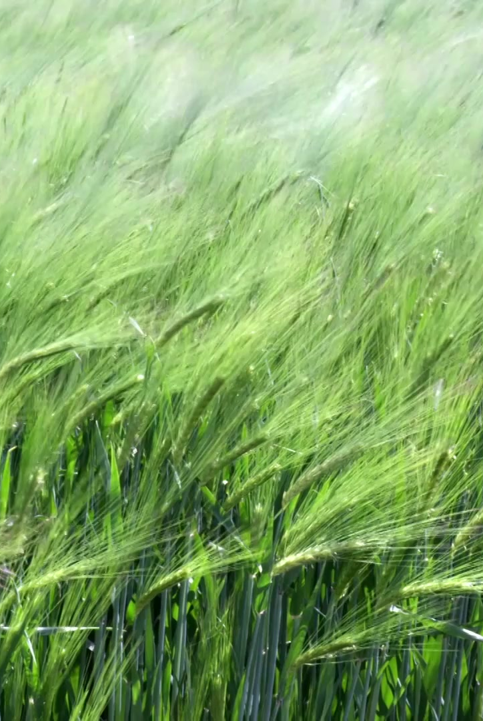
Impacts of high yielding varieties
Encourages monoculture
Incase attack by some pathogens, there is total devastation of crop by diseases due to exactly uniform condition, which help in the spread of the disease.

Slide 67
Fertilizer related diseases
Micronutrient imbalance : example excessive use fertilizer lead to deficiency of zinc in the soil of Punjab and Haryana which is affecting the productivity of soil.
Nitrate pollution : nitrogenous fertilizers applied in the field often leaches to the and ultimately contaminated the groundwater. when the concentration exceeds beyond 25mg/l they become serious health hazards called blue baby syndrome. More prevalent in England, Demark ,Netherland, Germany and in some parts of India .

Slide 68
Eutrophication
Pesticides related problems
Creating super pest
Death of non target organisms
Biological magnification
Water logging
Salinity related problems
For more explanation kindly refer Text Book “Perspective in Environmental Studies By C. P. Kaushik and Anubha Kaushik)

Slide 69
DAMS
Temples of modern India ------ first prime minister of India
1550 dams ------ India
More than 600 --------Maharashtra
More than 250 -------- Gujarat
More than 130--------M.P
Highest dam------------ Tehri dam -----Bhagirathi river
Largest Dam of capacity -----Bhakara Dam-----Sutlej
River in H.P
Big dams have been sharp focus of environmental group because of Ecological problems and social problem

Slide 70

Dams
Benefits
Provide employment
Raising the standard and quality of life
Check in flood
Generates electricity
Reduce water shortage problem
Provide irrigation water to low lying areas
Promote navigation and fisheries
Provide drinking water to lower areas.

Slide 71
Environmental problems associated with Dams
Upstream
Downstream

Slide 72
Upstream problem
Displacement of tribal people
Loss of flora, fauna and forest.
Changes in fisheries and spawning ground
Siltation and sedimentation of reservior
Loss of non forest land
Stagnation and water logging near reservoir
Breeding of vector borne diseases
Reservoir induced seismicity causing earthquakes.
Growth of aquatic weeds
Microclimate changes.

Slide 73
Downstream problems
Water logging and Salinity due to over irrigation
Microclimate change
Reduced water and slit deposition
Flash floods
Salt water intrusion at river mouth
Loss of land fertility along the river since sediments carrying nutrients get deposited in the reservoir
Outbreak of vector borne diseases like malaria

Slide 74
Land resources
Is a finite and valuable resource
Depend on land for fibre, fruits & fuel woods
Soil especially the topsoil is considered as renewable resource because it is continuously regenerated by natural process through at a very slow rate

Slide 75
SOIL RESOURCES
The top layer of the earth is called soil, which is very fertile because it contains minerals and humus
Soil is natural habitat for plants and animals It provides water and nutrients to the living organisms
Soil is much damaged through tree cutting running water and wind

Slide 76
SOIL RESOURCES (Contd…..)
It has been estimated that from 1959 to 1969 there was a loss of 16.9 lacs of hectare of land
Trees check the force of strong winds which causes the fertile soil to move from its original place. Thus trees act as wind breakers
Roots of the soil bind the soil firmly. This prevents the soil erosion from rain and floods and fertile soil is checked from damage

Slide 77
SOIL RESOURCES (Contd…..)
The lithosphere is the solid, rocky crust covering entire planet
Also known as crust. This crust is inorganic and is composed of minerals. It covers the entire surface of the earth from the top of Mount Everest to the bottom of the Mariana Trench
Silica and Aluminium dominate in this layer and hence it is sometimes called ‘Sial’
Its average thickness is about 20 Kms ( 8-40 Kms)
It is thin below ocean beds and thick in continents
Crust comprises 0.4 % of the total mass of earth

Slide 78
SOIL RESOURCES (Contd…..)
Soil is the topmost layer of earth’s surface which is composed of mineral and organic matter and is capable of sustaining plant life.
Word soil has been derived from latin word ‘solum’ which means topmost layer of crust. It is a dynamic layer of crust which goes on changing and developing constantly.
Soil is formed by wear and tear of the crust, a process which has been going on through the ages. This process is called weathering

Slide 79
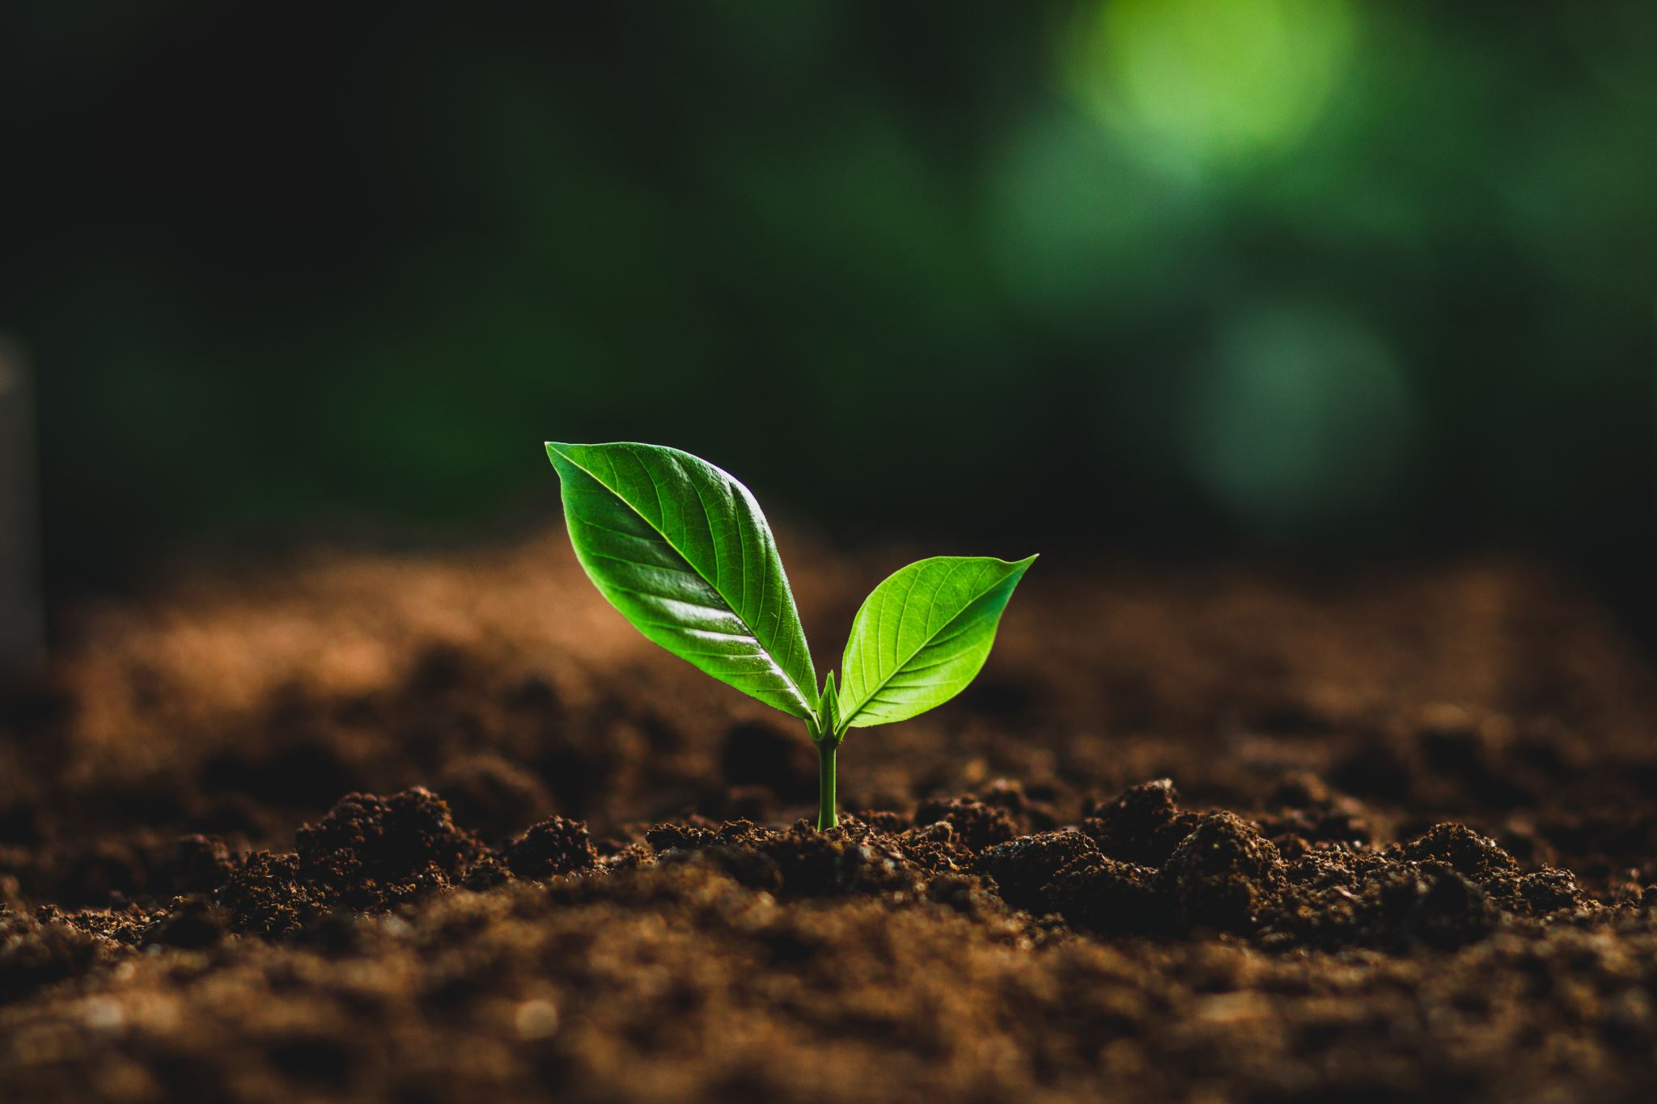
Component of soil
The main components of soil are:
Inorganic material: It is parent material of soil. It is in the form of sand, silt, clay etc. which is formed by wear and tear of rocks and minerals. The chemical constituents of soil are nitrogen (helps in growth of plants), phosphorus (helps in the ripening of grain and increases the yield), potassium (determines the quality of grain), calcium (helps in growth of leaves which in turn provide food to plants) etc.
Organic Material: Organic matter is added to soil by dead animals and vegetation matter. This matter is decomposed by microorganisms to form humus. Humus helps in cementing the lose particles of sand, silt and clay; provides food to plants; improves water retention power of soil.
Water
Air
Microorganisms: These decomposers decompose dead animals and plants. They utilize the organic matter, derive energy and release inorganic substances. They fix atmospheric nitrogen. Animals like earthworms keep the soil porous.

Slide 80

Types of Soil
Depending on their origin
Residual soils ( Diluvial).
This type of soil is found at its place of formation. Such soils are common on hill slopes, foot hills or in the course of river
Transported Soil (Alluvial)
This type of soil is formed by deposition of material transported by river, wind etc. Alluvial soil in Gangetic planes is a good example

Slide 81
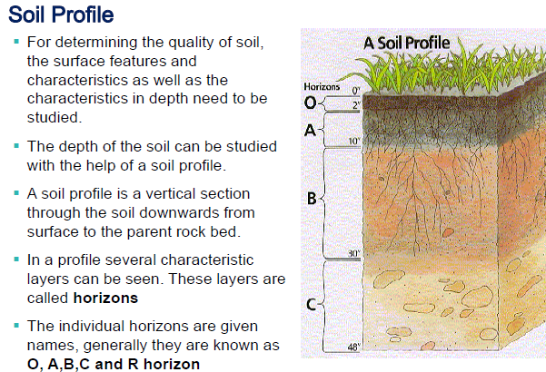

Slide 82
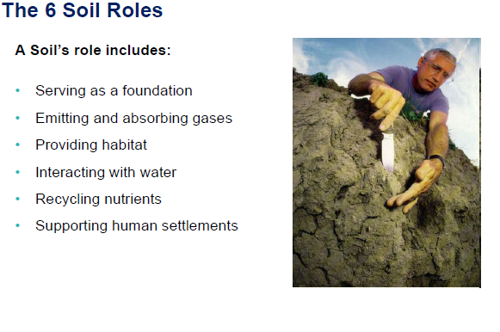

Slide 83
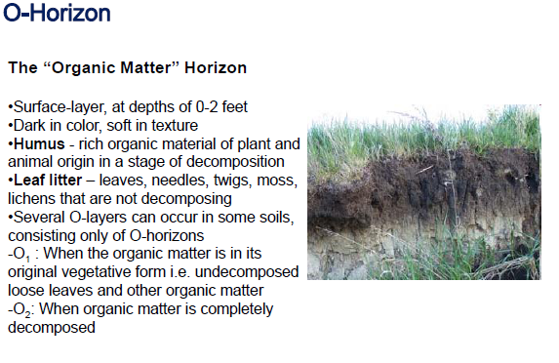

Slide 84
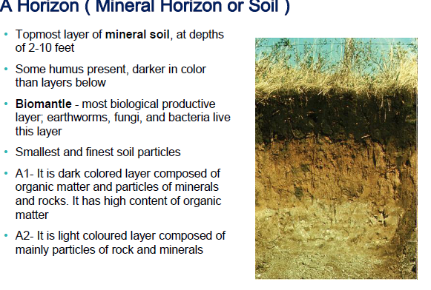

Slide 85
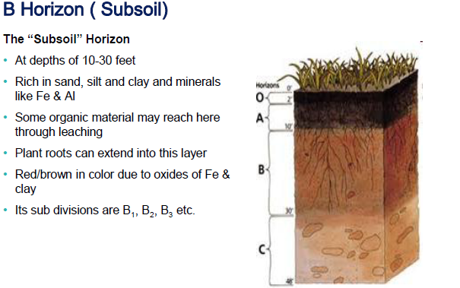

Slide 86
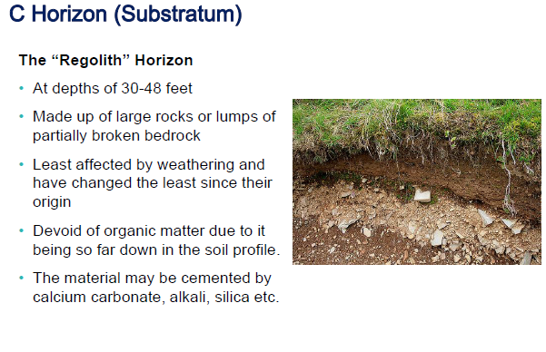

Slide 87
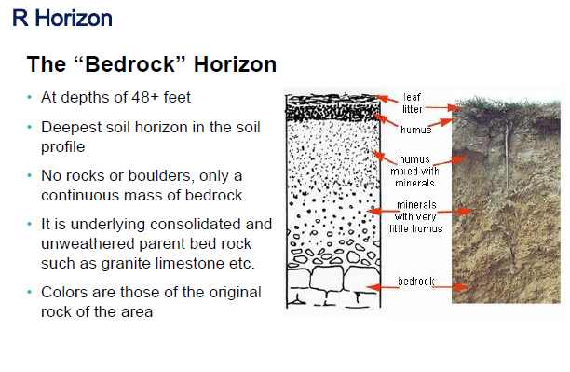

Slide 88

Soil erosion
Wearing away of soil.
Defined as movement of soil component especially surface litter and top soil from one place to other

Slide 89
Types of soil erosion
Based on cause
Normal erosion
Accelerated erosion
Based on Climatic agents
Water Erosion
Wind erosion
Based on Biotic Agent

Slide 90
Water Erosion
Sheet erosion
Rill erosion
Gully erosion
Slip erosion
Stream bank erosion

Slide 91
Wind erosion
Saltation (1-1.5 mm diameter particles)
Suspension ( less than 1mm dia)
Surface creep ( 5-10mm diamater)

Slide 92
Biotic Agent
Excessive grazing
Mining without land reclamation
Irrigation techniques that leads to salt build up
Water logged soil
Farming on land with unsuitable terrain
Soil compaction by agricultural machinery
Deforestation without reforestation
Top soil is disturbed ,devoid of vegetation cover ----- land is directly exposed to action of various physical forces---- cause erosion

Slide 93
Overgrazing ---- 35% of world’s soil erosion
Deforestation ---- 30% of earth’s seriously eroded lands .
Unsustainable methods of farming ---28% of soil erosion.

Slide 94
Ways to Control soil erosion
Soil fertility can be restored by supplementing manures and fertilizers
Plants and animals when die are decomposed by bacteria and fungi, which increase the fertility of soil
Contour farming
On gentle slopes , crops are grown in rows across, rather than up and down , a practice is known as contour farming . Each row planted horizontally along the slope of the land acts as a small dam to help hold soil and slow down loss of soil through run off water

Slide 95
Ways to Control soil erosion (contd.)
Terrace farming: It is used on steeper slopes are converted into a series of broad terraces which run across the contour. Terracing retains water for crops at all levels and cuts down soil erosion by controlling run off .
Strip cropping: Here strips are alternated with strips of soil saving cover crops like grasses or grasses legume mixture .Whatever run off comes fro the cropped soil is retained by the strip of cover crop and this reduces soil erosion. Nitrogen fixing legumes also help in restoring soil fertility of soil.

Slide 96
Ways to Control soil erosion (contd.)
Alley cropping : It is a form of intercropping in which crops are planted between rows of tress or shrubs .this is also called agro forestry .Even when crops are harvested the soil is not fallow because tress and shrubs still remains on the soil holding the soil particles and prevents soil erosion
Windbreakers: They help in reducing erosion caused by strong winds .tress are planted in long rows along the cultivated land boundary so that wind is blocked. Wind speed is substantially reduced which help in preventing wind erosion

Slide 97
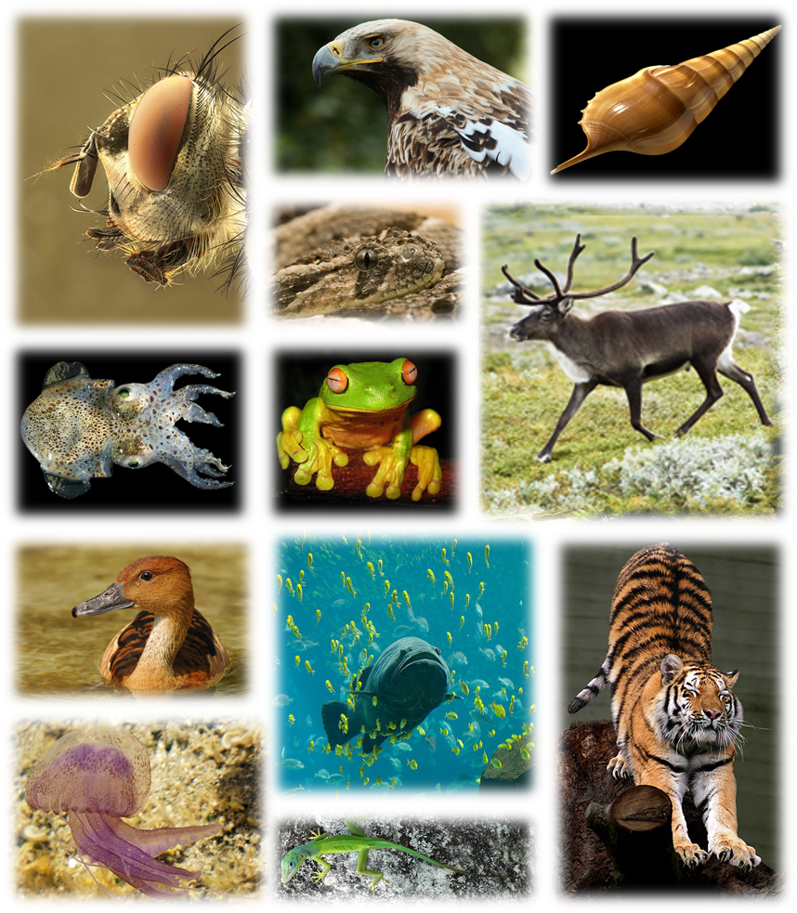
Biodiversity
https://en.wikipedia.org/wiki/Global_biodiversity

Slide 98
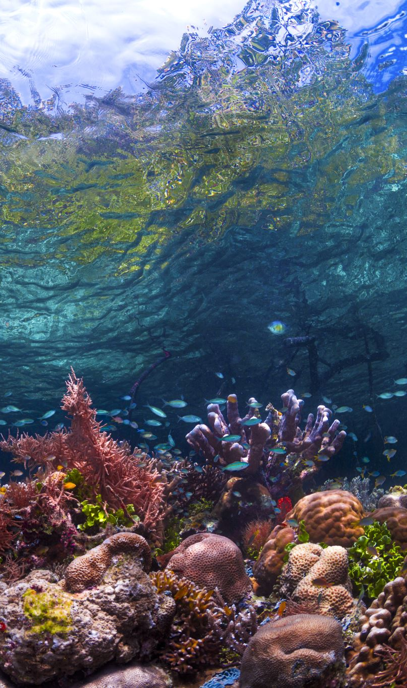
Biodiversity
Refers variety and variability among all groups of living organisms and the ecosystem complexes in which they occur.
Or
In the convention on Biological Diversity (1992) ,biodiversity has been defined as the variability among living organisms from all sources including inter alia terrestrial, marine and other aquatic ecosystem and the ecological complexes of which they are a part

Slide 99
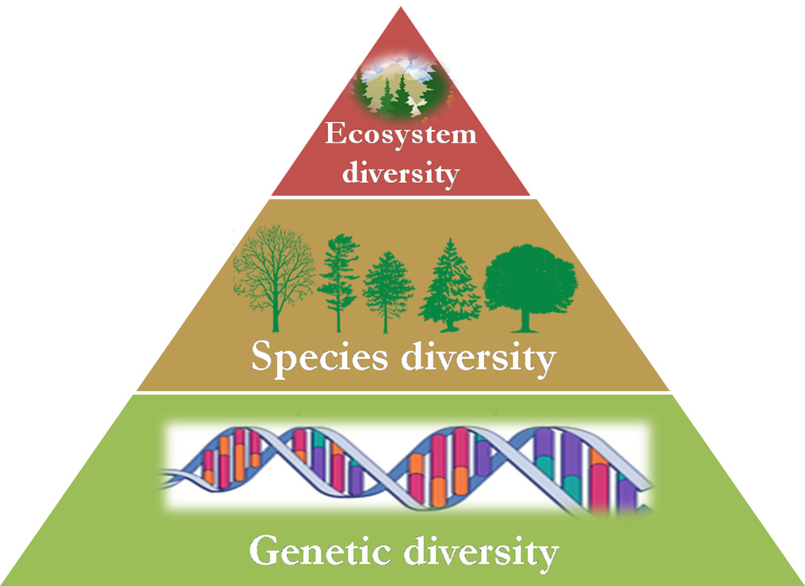
Levels of biodiversity
Genetic
Species
Ecosystem
https://www.google.com/imgres?imgurl=https%3A%2F%2Fmedia.springernature.com%2Foriginal%2Fspringer-static%2Fimage%2Fprt%253A978-3-319-95981-8%252F7%2FMediaObjects%2F978-3-319-95981-8_7_Part_Fig1-53_HTML.png&imgrefurl=https%3A%2F%2Flink.springer.com%2F10.1007%2F978-3-319-95981-8_53&tbnid=MijFRO0QpNe_qM&vet=12ahUKEwibh-3fuP_1AhUR_DgGHaLFCZgQMygEegUIARC_AQ..i&docid=N3N__Paw0RFuLM&w=1016&h=740&q=genetic%20diversity&ved=2ahUKEwibh-3fuP_1AhUR_DgGHaLFCZgQMygEegUIARC_AQ

Slide 100

Genetic diversity
Basic source of biodiversity
Gene found in organisms can form enormous combinations each of which give rise to some variability.
Gene are basic source of hereditary
Gene within same species show different versions due to new combination ,it is called genetic variability.

Slide 101
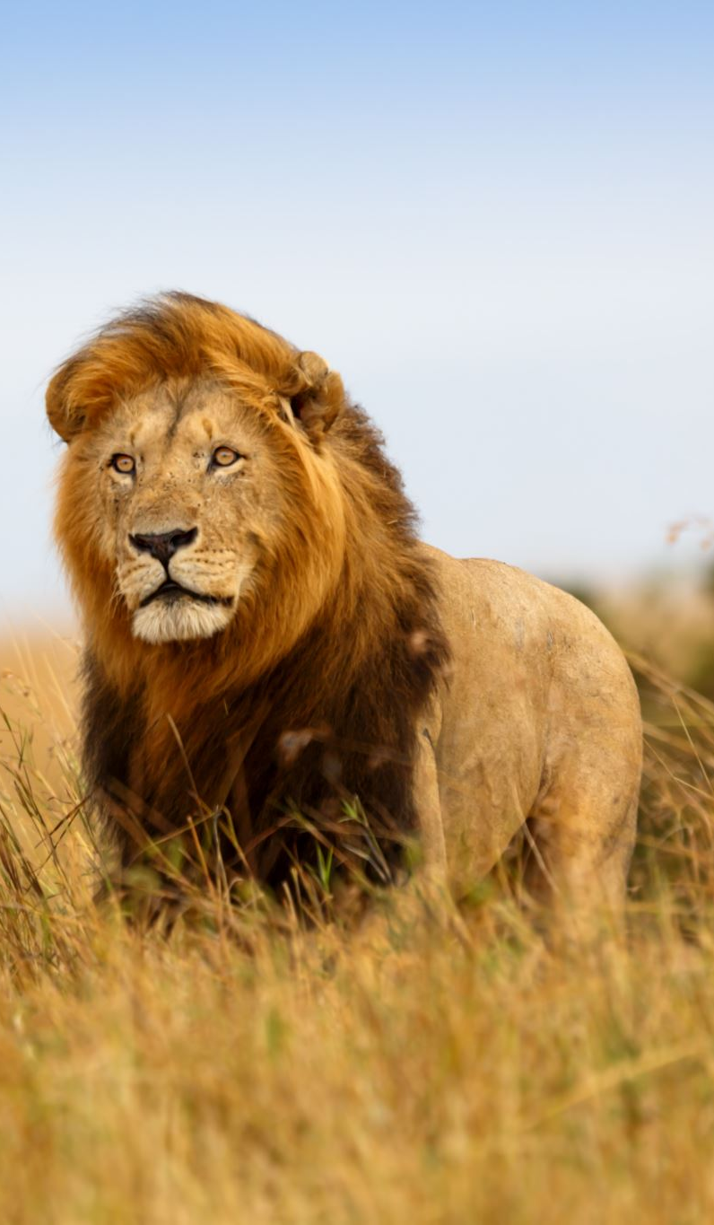
Species diversity
Variability found within the population of a species or between different species of a community n
Represent species richness and abundance .
Two index for measuring species diversity are
Simpson index
Shannon wiener index

Slide 102
Ecosystem diversity
This is the diversity of ecological complexity showing variation in ecological niches ,trophic structure, food webs, nutrient cycling .
The ecosystem also show variation in moisture, temperature ,altitude, precipitation

Slide 103
Based on the spatial distribution the biodiversity at local level is classified as follows
Point richness refers to the number of species that can be found at a single point in a given space.
Alpha (α-) richness refers to the number of species found in a small homogeneous area
Beta (β-) richness refers to the rate of change in species composition across different habitats.
Gamma (γ-) richness refers to the rate of change across large landscape gradients.

Slide 104
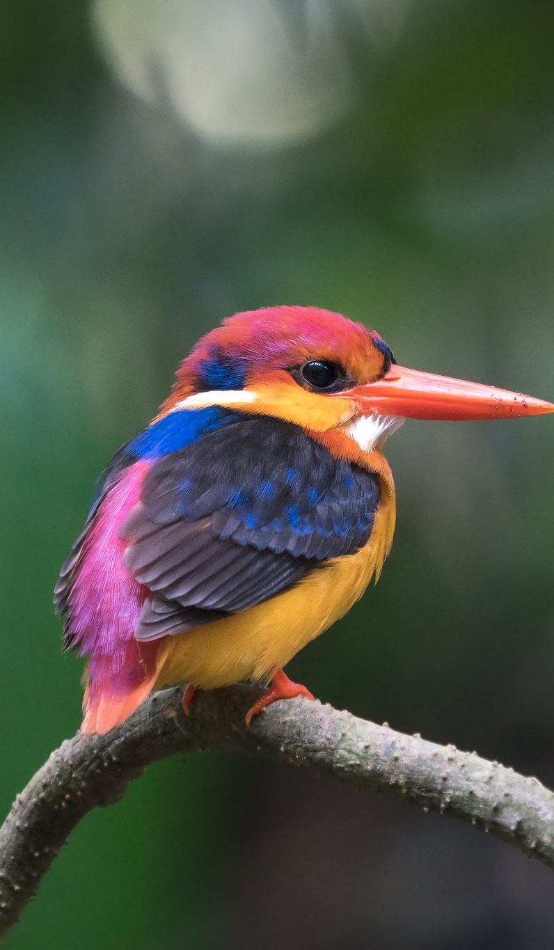
India as Mega Biodiversity
47000 species of plant
89451 species of animal
India is considered as a Mega Diversity region because it has wide variety of endemic flora and fauna.

Slide 105

Bio Geographical Classification
India has different types of climate and topography in different parts of the country .
These variation have induced enormous variability in flora and fauna .
India occupies 10th position among plant rich nation in the world
Biogeography comprises both phyto geography and zoogeography deals these aspects of plants and animals .

Slide 106
Occurrence of plants and animals in a particular area is dependent upon its environment .
Similar plants and animals found in a separate areas but having similar climate. Such areas form a bio-geographical type .
In order to gain insight about the distribution and environmental interaction of flora and fauna of the country India is divided into 10 Biogeographical region

Slide 107
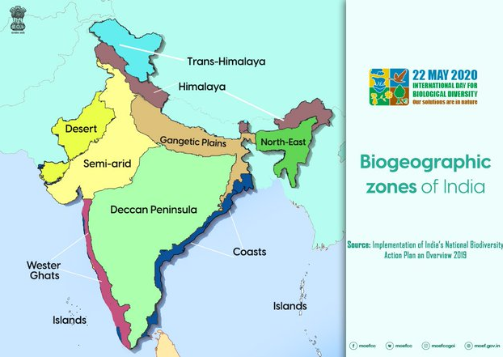
Bio Geographical Classification
Trans Himalayan
Himalayan
Desert
Semi arid
Western Ghat
Deccan Pennisular
Gangetic Plain
North East India
Islands
Coasts

Slide 108
Trans Himalayan
Biogeographic Zone
Upper region
Important flora and fauna
Pine ,deodar
wild sheep, Yak, Tibtean ass, Snow leopard Marmot, Wolf ,Black necked crane.

Slide 109
Himalayan
Desert
Biogeographic Zone
North West Himalayas
West Himalayas
Central Himalayas
East Himalayas
Important Flora and Fauna
Pine, cork tree, Sal, Dhaak, Castor
Wild bear ,Sambar, leopard, Sikkim Stag, Musk Deer
Biogeographic Zone
Kutch,
Thar ,
Ladakh
Important Flora and Fauna
Acia, Zizyphus ,Khejri, Date palm
Camel, Bastard ,Ass, Desert, Cat ,Fox ,Rat

Slide 110
Semi arid
Western Ghats
Biogeographic Zone
Central India ,Gujarat –Rajwara
Important Flora and Fauna
Acacia, Date Palm, Peepal
Gir Lion ,Tiger
Sariska ad Ranthambore
( tiger Reserve )
Biogeographic Zone
Malabar Coat ,Western Ghat Mountain
Important Flora and Fauna
Sheesham, Peepal, Tuna , Bahera
Tortoise, Frog ,Lizards ,Snakes

Slide 111
Deccan Peninsula
Gangetic Plain
Biogeographic Zone
Deccan Plateau
South Central Plateau
Eastern Plateau
Chhota Nagpur
Central Highlands
Important Flora and Fauna
Acacia ,Palash , tuna
Tiger, Cheetal ,Four horned Stag
Biogeographic Zone
Upper Gangetic and
Lower Gangetic plain
Important Flora and Fauna
Sal ,Acacia, Jamun, Mango
Stag, Rhinoceros ,Gazzel, Turtle , Black Chinkara

Slide 112
North East India
Islands
Biogeographic Zone
Brahmaputra valley
North East hills
Important Flora and Fauna
Bamboo, Sal , Jack fruit
Yak ,Deer, Rhino
Biogeographic Zone
Andaman and Nicobar Island , Lakshadweep Island
Important Flora and Fauna
Coconut, Clove, Cardamom
Dolphin Molluscs

Slide 113
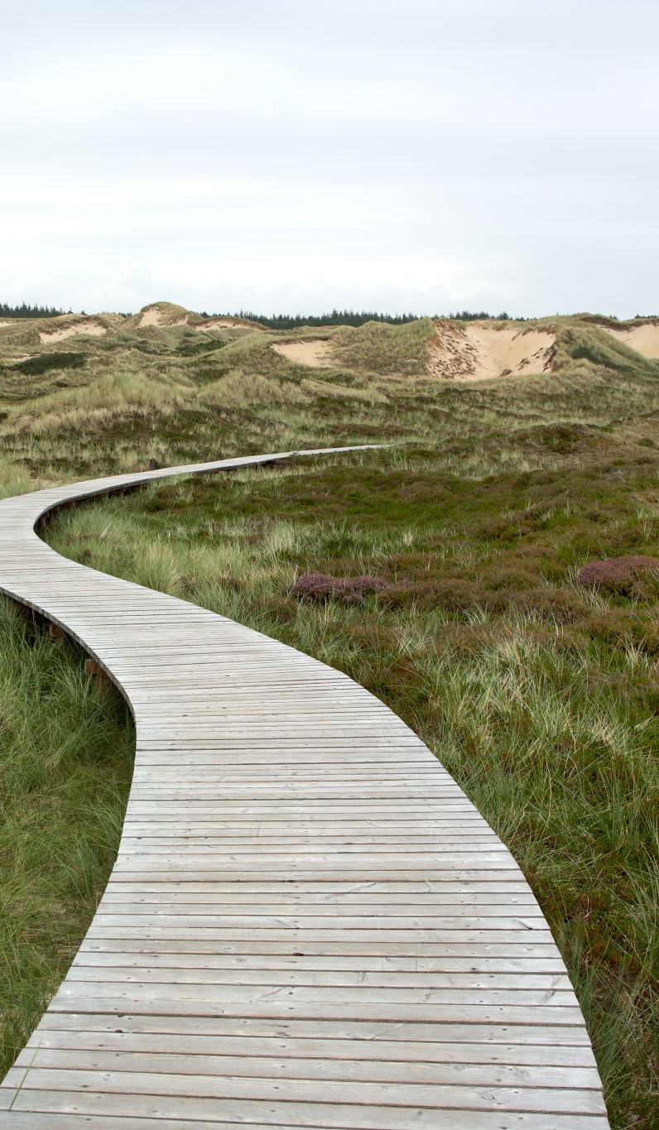
Coast
Biogeographic Zone
East
West
Important Flora and Fauna
Coconut, Banana
Cashew nut
Turtle, alligator, Molluscs

Slide 114
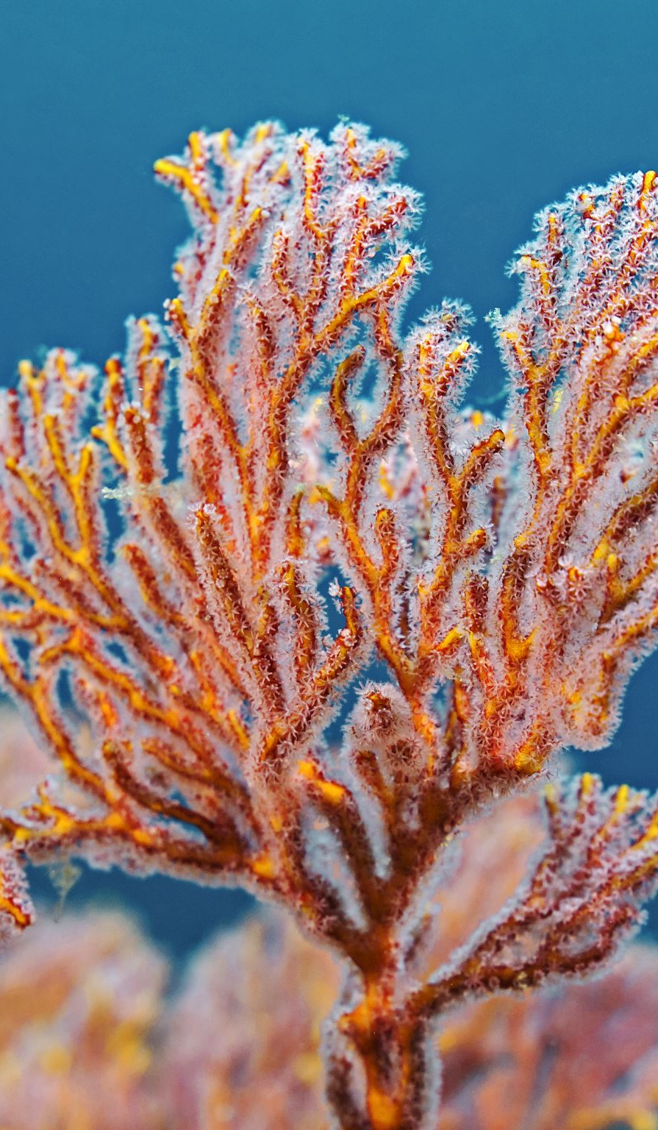
Hot spots of Biodiversity
The area that are extremely rich in biodiversity that harbor great diversity of endemic species and at the same time they have been significantly degraded by human activities.
Norman Meyer (1988) coined this hotspot concept.
Hotspots region must satisfy the following condition
It must support 15000 endemic plant species.
that have lost 70 % of its original habitat
There are 25 hot spots in the world.
India’s Hot– spots are Eastern Himalaya & Western Ghat

Slide 115
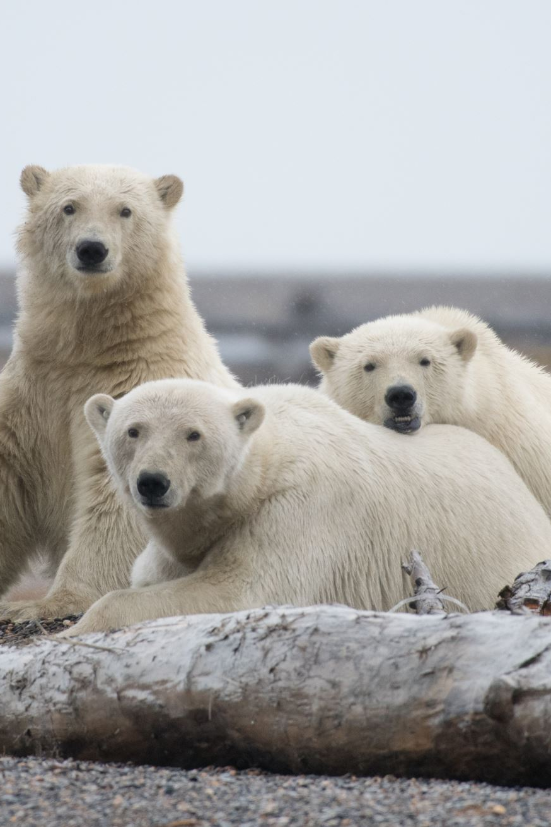
Endemic Species
The species which are confined to a certain region. It may be continent, country, state or even small ecosystem.

Slide 116
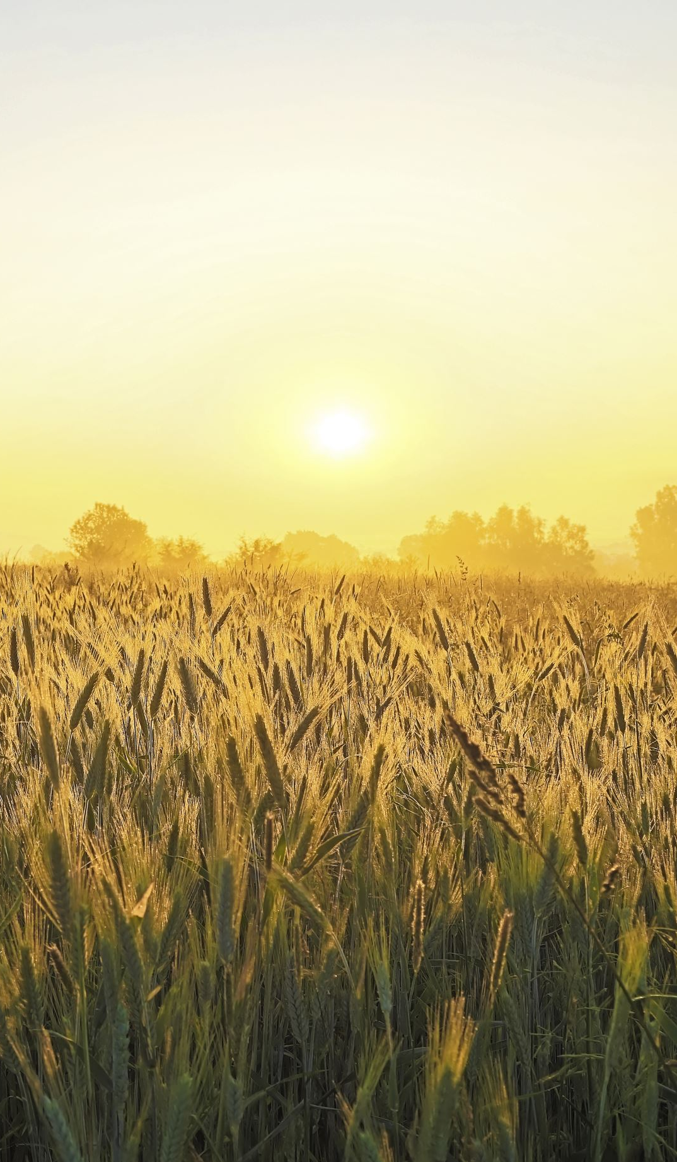
Value of biodiversity
Consumptive value
Productive value
Social value
Aesthetic value
Ethical value
Optional value
Ecosystem services

Slide 117
Consumptive value
Food : Sources of Food:
Plants: There are about 3000 species of food plants out of which only 150 species are commercialized. Plant provide wide variety of food like maize, wheat, rice.
Animal: Man consume meat from mainly nine species of animal like cattle, ship, pig, goat, water buffaloes, chickens, duck, geese and turkeys.
Fishes are now regarded as a domesticated animal because of development of aquaculture.
Curd, cheese milk are obtained from dairy farms.

Slide 118
Sources of Fats and Oil
Now a days most commonly used oil seed plant like mustard , ground nut, palm oil. The other oil like soyabean, binola(cotton seed) , sunflower are becoming popular.
Fibres
Major fiber yielding varieties are cotton, flax, jute, sisal, coir, abaca

Slide 119
New disease resistant varieties:
Some commercial species of food plants are susceptible to certain disease. These species can be made resistant to particular disease by cross bred.
Eg. Potato has been made resistant to late blight by deriving a resistant strain from Solanum Demissum.
Drug and Medicine
A number of herb has been used to cure various ailments.
Various plant contain valuable drugs. Eg. Rosy Periwinkle plant is used for treatment of cancer.
Tulsi has the property of antibacterial.
Quinine is used for the treatment of malaria.
The importance of herbal plant for ailment of various disease was discussed our ancient Scriptural Ayurveda.

Slide 120
Fuel
Coal
Petroleum are fossilized biodiversity .

Slide 121
Productive value
Tusk------------------- elephant
Musk -------------------musk deer
Lac ------------------------lac insect
Silk ------------------------silk worm
Fur of many animals

Slide 122
Social value
Since the ancient time our culture and festival were associated with various plant and animals. Eg. Banyan Tree, Peepal, Tulsi has been worshipped by women of India. Some animal like cow is considered our mother.
Some animal and plant considered as a national symbol like Peacock, Tiger, Lotus, Banyan.

Slide 123
Aesthetic value
Biodiversity provide lots of aesthetic and beautification value. Human being is fond of maintaining garden, keeping pets, ecotourism.
We go to various hill station, national park , zoological garden , sanctuaries to watch scenic beauties.

Slide 124
Ecosystem services/ Ecological role
Protection of Water resource
Forest and plant cover in water catchments area help
To maintain hydrological cycle.
Acting as a buffer against natural calamities like flood and drought.
Forest increase the water table.
Regeneration of natural spring.
Eg. Wet land and forest act as a water purifying system while mangroves trap silt reducing impact of sea waves, tides or Tsunami.

Slide 125
Nutrient Storage and Cycling
All the nutrient are recycled in nature. These nutrient found in air, water, soil.
Plant take up these nutrient from air, water, soil which enter in the animals body through food chain. After the death of plant and animal these nutrient come back in the environment through decomposition process which is carried out by bacteria and fungi.
Some bacteria and fungi convert the atmospheric nitrogen into nitrate, nitrite through biological nitrogen fixation .
For eg. Rizobium Leguminous relationship.
Rhizobium is one of the main N2 – fixing bacteria living in the nodules of root of leguminous plants.

Slide 126

Maintaining Climate Stability
Vegetation affect climate at macro and micro level. Dense
forest promote rainfall by recycling of water vapor.
Reducing Pollution
Different kind of bacteria , fungi and protozoa are well known for the decomposition and break down micro – organism.
These microorganism absorb the pollutant like sewage, garbage and oil spills.
Natural and artificial wetland are being used to filter effluent to remove nutrient.

Slide 127
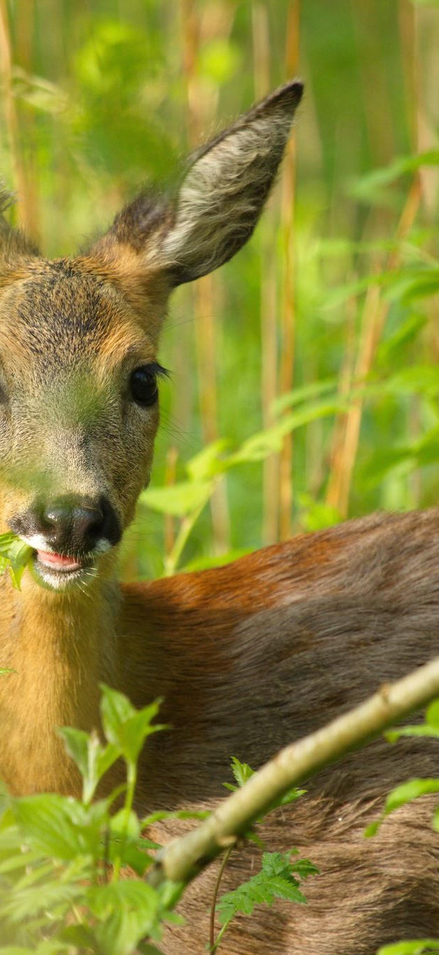
Maintenance of Ecosystem
All species are equally important in our ecosystem. Disruption of one species can lead to destruction of whole ecosystem. According to food chain and food web all species of plant and animal are interrelated with each other.
For e.g Plant ---- deer------lion
If the population of lion is destroyed the population of deer can increase in excess and overpopulation of deer will eat up whole grasses in grassland ecosystem thus making into degraded ecosystem.
If the population of deer decreased it can lead to overgrowth of plant that will lead to competition between the various species of plants and in this way whole ecosystem can be degraded.
Forest regulate O2 and CO2 cycle.
Forest play important role in recycling of nutrient.

Slide 128
Surviving from natural Calamities
Natural calamities like floods, drought, cyclone, typhoon, forest fire, land slide are mostly unpredictable event and proved to be hazardous for all human being.
Natural calamities cause loss of lives, properties and building.
Forest act as a buffer against all these calamities it control floods and cyclone

Slide 129
Option value
These value include the potentials of biodiversity that are presently unknown and need to be explored.
For eg potential cure for AIDS &cancer are in the depth of ocean ecosystem and tropical rainforest.

Slide 130

Ethical value
Live and let live .
It means that we may or may not use a species but knowing the very fact that this species exist in nature give us pleasure.
Feel sorry for Passenger pigeon and Dodo bird is no more on earth

Slide 131
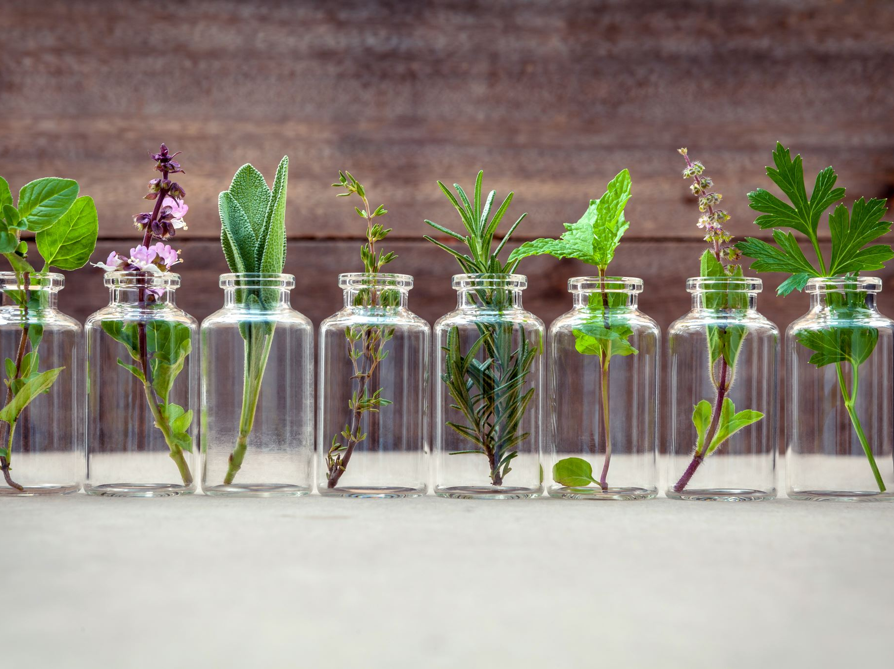
Loss of biodiversity

Slide 132
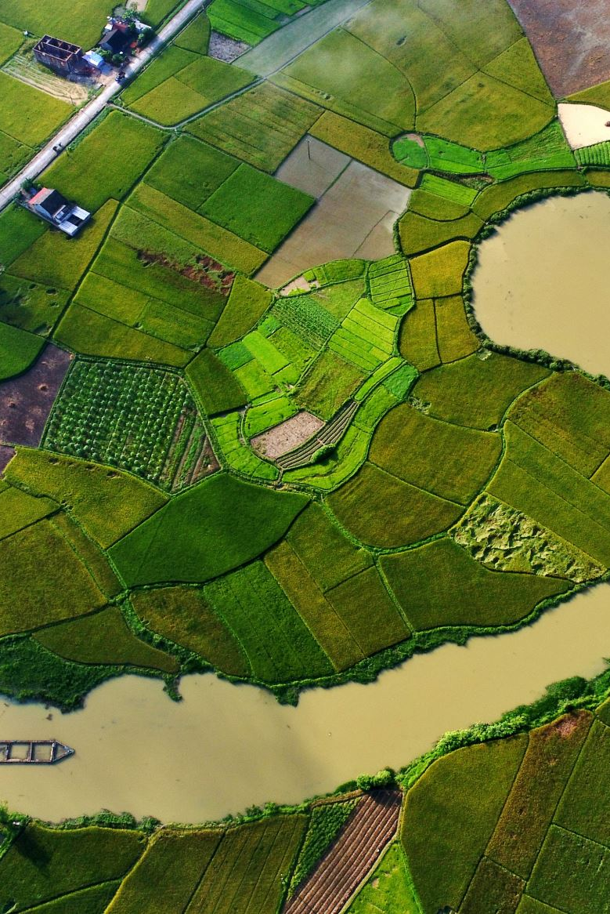
Habitat loss and fragmentation
Increasing population is leading to urbanization and industrialization which require more land every year.
There is destruction of natural habitat through
filling of wetland ,
cutting tree,
ploughing grassland
burning forest.

Slide 133

https://sustain.round.glass/explainers/explainer-habitat-fragmentation/#images

Slide 134

Disturbance and degradation
Natural disturbance like flood, earthquake, forest fire, pest infestation like coast attack
Man made disturbance
like felling of trees, litter accumulation
pollution lead to degradation of habitat and loss of biodiversity.

Slide 135

Selective Forestry
Due to profit motive there is tendency to grow economically lucrative tree for economic benefit. Eg. Sal, Teak, Eucalyptus
Due to this tendency other species are driven away from the area.

Slide 136
Over Exploitation
Due to overexploitation of natural resources some time many species become endangered and vulnerable which may extinct in near future.

Slide 137

Intensive Agriculture
Grassland , forest and wetland are destroyed to make way for cultivation of land. Destruction of biodiversity mainly caused by excessive use of chemical fertilizer and pesticides
Application of Hybrid varieties of plant which are genetically modified that resulted loss of traditional varieties.

Slide 138

Poaching
Trade pay large amount of money to poacher and smuggler. Trade for live specimen , furs, hides, skin
Although strict law have been made yet these product are widely traded

Slide 139
Pollution
Excessive use of pesticides pollute the water which prove harmful to certain species. Runoff fertilizer may lead to Eutrophication
Air pollution, soil Pollution and water pollution cause deleterious impact on various species of flora and fauna

Slide 140
Disease
Pathogen may attack certain species and destroy entire population.
The incidence of disease in wild species is on rise due to human activities.

Slide 141
Red Data Book
IUCN publishes the red data book which includes the list of endangered species of plants and animals.
Red symbolizes warning signals for those species which are endangered and if not protected are likely to become extinct in near future.

Slide 142

EXTINCT SPECIES
A species is not seen in the wild for 50years at a stretch
Example Dodo ,Passenger Pigeon

Slide 143

ENDANGERED SPECIES
A species is said to be endangered when its numbers has been reduced to critical levels or whose habitat, have been drastically reduced and if such a species is not protected and conserved, it is in immediate danger of extinction.
https://visualdictionary.org/endangered-species/

Slide 144

VULNERABLE SPECIES
A species is said to be vulnerable if its population is facing continuous decline due to overexploitation or habitat destruction .
Such a species is still abundant, but under a serious threat of becoming endangered if casual factors are not checked.

Slide 145

RARE SPECIES
Species are not endangered or vulnerable at present ,but are at risk are categorized as rare species.
These taxa are usually localized within restricted areas i.e. they are usually endemic. Sometimes they are thinly scattered over a more extensive area.
https://www.thebetterindia.com/25528/7-rare-and-exotic-wildlife-species-that-can-be-found-in-india/

Slide 146
Conservation of biodiversity includes all human efforts to preserve wild animals and plants from extinction. It involves the protection and wise management of wild species of plants an animals at their environment. Their 02 basic categories in this regards- In situ conservation Ex situ conservation

Slide 147

https://stellariasacademy.online/conservation-of-biodiversity/21/02/

Slide 148
In situ conservation
In- situ conservation means the conservation of the species in it natural ecosystem.
In –order to promote in –situ conservation protected area have been developed like
National park,
Sanctuaries and
Biosphere reserve etc

Slide 149

National Park
It is habitat oriented.
It has been developed for the conservation of habitat of particular species.
Activities like forestry, grazing and cultivation are not permitted here.
No private ownership of land is allowed here.
National park usually devoted to habitat and betterment of particular wild species like Tiger, Lion.
Limited human activities is allowed in buffer zone but no biotic interference is tolerated.

Slide 150

National Park

Slide 151


Slide 152

Sanctuary
This is more generally species oriented as for Great Indian Bustard and Pitcher Plant
Human activities like collection of fuel , fodder, litter are allowed but they should not interfere life of animal.

Slide 153
Biosphere Reserve
Biosphere programme have been launched under MAB (Man and Biosphere Reserve Programme in 1971.
It is ecosystem oriented.
It is a special category of protected area of land devoted to totality of all term of life.

Slide 154
It may be divided into three categories
1. Core Zone : This area is legally protected and remain undisturbed.
2. Buffer Zone: It can be used educational activities and research.
3. Transition Zone: Here is active co-operation between reserve manager and local in habitant. All kind of activities can take place here provided that they do not disturb the harmony of Biosphere.

Slide 155
Name of the site
1. Nilgiri – Silent Valley and Siruvani hills (Tamil Nadu, Kerala and Karnataka)
2. Nanda Devi -Part of Chamoli, Pithoragarh, Almora Districts (Uttaranchal)
3. Nokrerk -Part of Gora Hills (Meghalaya
4. Manas - Assam
5. Sunderbans -West Bengal
6. Gulf of Mannar : Gulf of Mannar between India and Sri Lanka (Tamil Nadu) Great Nicobar
7. Similpal - Orissa
8. Dibru Saikhowa - Arunachal Pradesh

Slide 156
9. Dehang Debang-Madhya Pradesh
10. Pachmarhi - Madhya Pradesh
11. Kanchanjanga- Sikkim

Slide 157


Slide 158

Ex-situ Conservation
Conservation of the species from outside their natural habitat . In other word it is in captivity under human care.
The endangered species of animals are collected and bred under controlled condition in Zoo, Farm and Aquarium. Plant Species are kept in botanical garden, Botanical Garden, Zoological Garden, Seed Bank ,Pollen Storage

